Slide 1
Evaluating Limits Algebraically

Slide 2
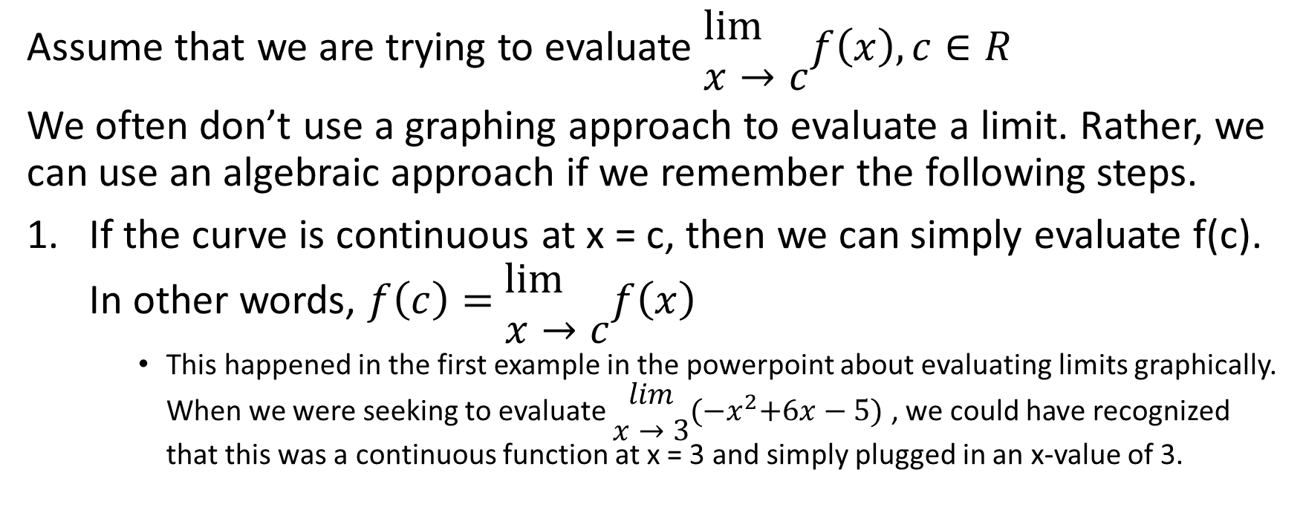
Assume that we are trying to evaluate $\begin{matrix}\lim{} \\ x→c\end{matrix}f\left(x\right),c∈R$
We often don’t use a graphing approach to evaluate a limit. Rather, we can use an algebraic approach if we remember the following steps.
If the curve is continuous at x = c, then we can simply evaluate f(c). In other words, $f\left(c\right)=$ $\begin{matrix}\lim{} \\ x→c\end{matrix}f\left(x\right)$
This happened in the first example in the powerpoint about evaluating limits graphically. When we were seeking to evaluate $\begin{matrix}lim \\ x→3\end{matrix}{(−x}^{2}+6x−5)$ , we could have recognized that this was a continuous function at x = 3 and simply plugged in an x-value of 3.

Slide 3
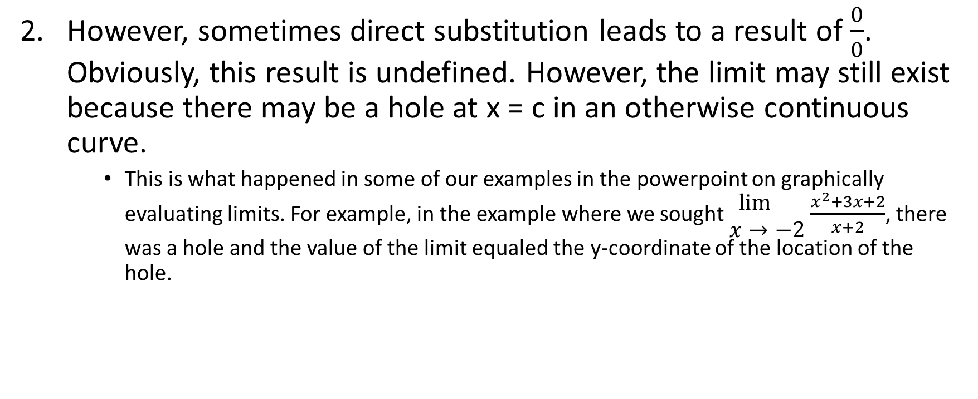
However, sometimes direct substitution leads to a result of $\frac{0}{0}$. Obviously, this result is undefined. However, the limit may still exist because there may be a hole at x = c in an otherwise continuous curve.
This is what happened in some of our examples in the powerpoint on graphically evaluating limits. For example, in the example where we sought $\begin{matrix}\lim{} \\ x→−2\end{matrix}$ $\frac{x^{2}+3x+2}{x+2}$, there was a hole and the value of the limit equaled the y-coordinate of the location of the hole.

Slide 4
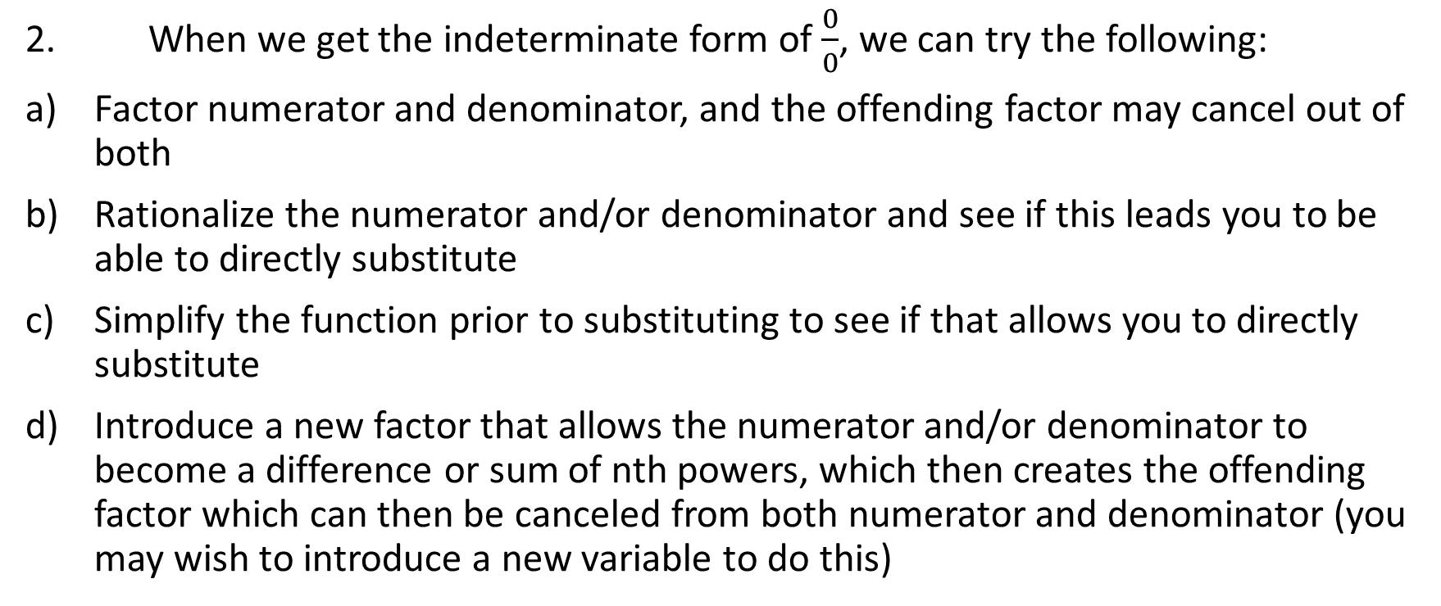
2. When we get the indeterminate form of $\frac{0}{0}$, we can try the following:
Factor numerator and denominator, and the offending factor may cancel out of both
Rationalize the numerator and/or denominator and see if this leads you to be able to directly substitute
Simplify the function prior to substituting to see if that allows you to directly substitute
Introduce a new factor that allows the numerator and/or denominator to become a difference or sum of nth powers, which then creates the offending factor which can then be canceled from both numerator and denominator (you may wish to introduce a new variable to do this)

Slide 5
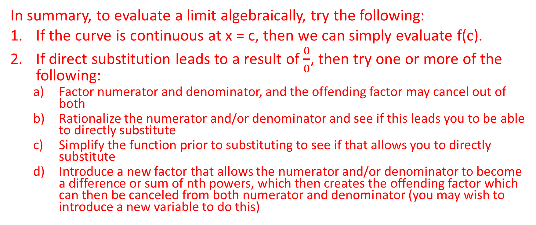
In summary, to evaluate a limit algebraically, try the following:
If the curve is continuous at x = c, then we can simply evaluate f(c).
If direct substitution leads to a result of $\frac{0}{0}$, then try one or more of the following:
Factor numerator and denominator, and the offending factor may cancel out of both
Rationalize the numerator and/or denominator and see if this leads you to be able to directly substitute
Simplify the function prior to substituting to see if that allows you to directly substitute
Introduce a new factor that allows the numerator and/or denominator to become a difference or sum of nth powers, which then creates the offending factor which can then be canceled from both numerator and denominator (you may wish to introduce a new variable to do this)

Slide 6
1. Examples where direct substitution leads to the correct answer

Slide 7

Example
Evaluate $\begin{matrix}lim⁡ \\ x→5\end{matrix} x^{2}+2x−3$

Slide 8
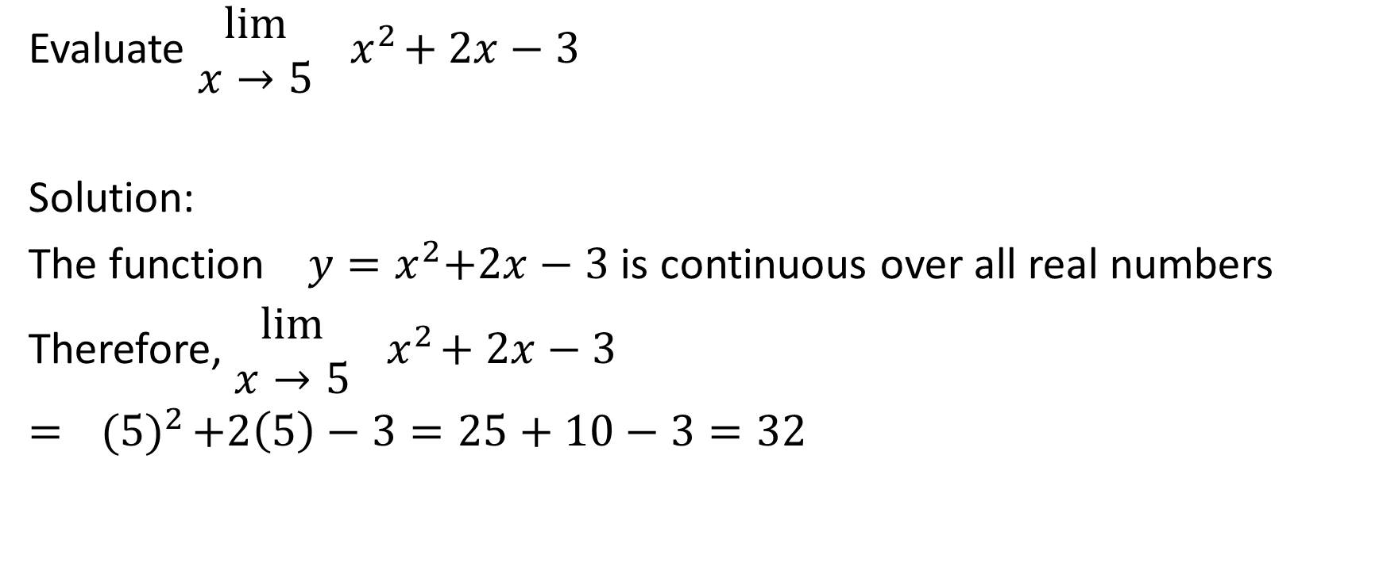
Evaluate $\begin{matrix}lim⁡ \\ x→5\end{matrix}{ x}^{2}+2x−3$
Solution:
The function ${ y=x}^{2}+2x−3$ is continuous over all real numbers
Therefore, $\begin{matrix}lim⁡ \\ x→5\end{matrix}{ x}^{2}+2x−3$
$={ (5)}^{2}+2\left(5\right)−3=25+10−3=32$

Slide 9

Example
Evaluate $\begin{matrix}lim⁡ \\ x→5\end{matrix} 11$

Slide 10

Evaluate $\begin{matrix}lim⁡ \\ x→5\end{matrix} 11$
Solution:
The function y = 11 is continuous over all real numbers
Therefore, $\begin{matrix}lim⁡ \\ x→5\end{matrix} 11$
$=11$

Slide 11



Evaluate $\begin{matrix}lim⁡ \\ x→5\end{matrix} 11$
Solution:
If it helps consider the function y = 11

Slide 12
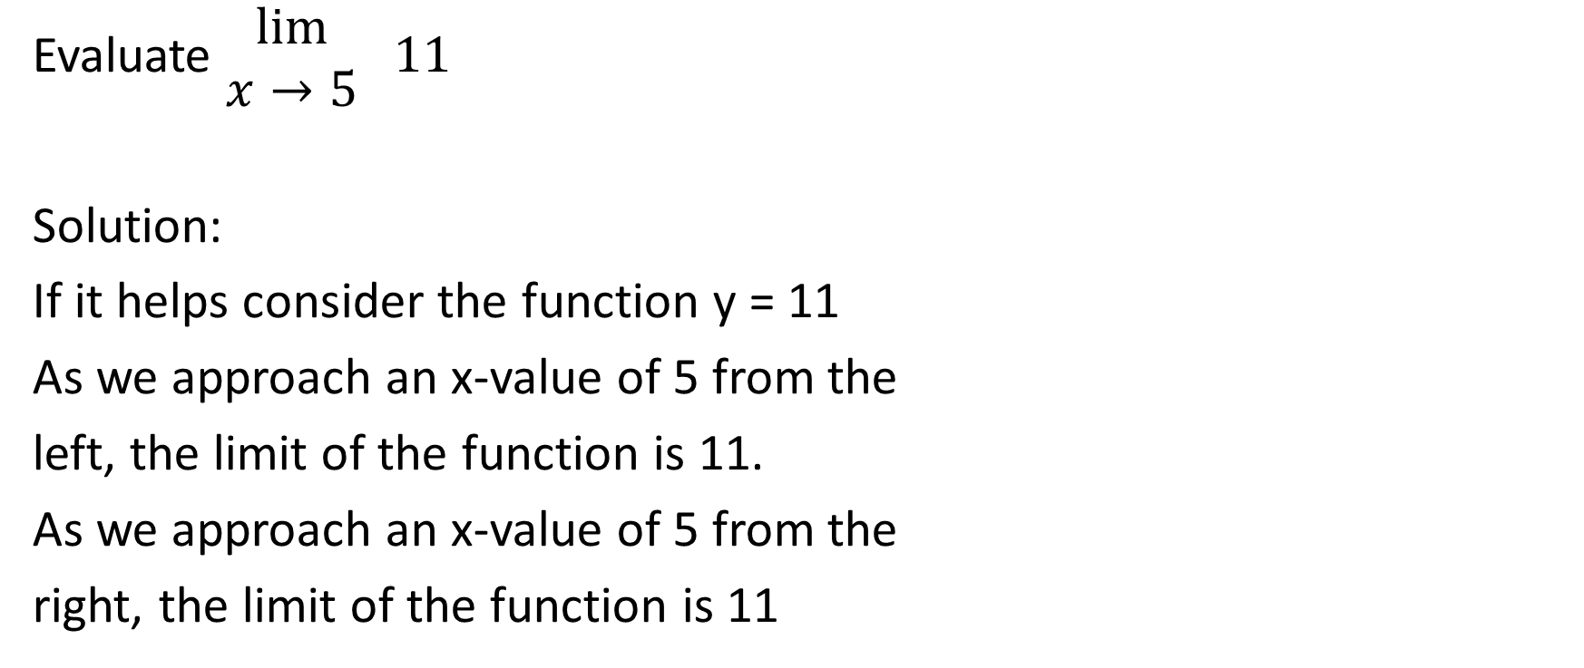
Evaluate $\begin{matrix}lim⁡ \\ x→5\end{matrix} 11$
Solution:
If it helps consider the function y = 11
As we approach an x-value of 5 from the
left, the limit of the function is 11.
As we approach an x-value of 5 from the
right, the limit of the function is 11

Slide 13

Evaluate $\begin{matrix}lim⁡ \\ x→5\end{matrix} 11$
Solution:
Since we get the same value from both sides,
therefore $\begin{matrix}lim⁡ \\ x→5\end{matrix} 11=11$

Slide 14
Evaluate $\begin{matrix}lim⁡ \\ x→5\end{matrix} 11$
Solution:
Since we get the same value from both sides,
therefore $\begin{matrix}lim⁡ \\ x→5\end{matrix} 11=11$
Sometimes, imagining the limit being evaluated graphically can help us to evaluate a limit algebraically.

Slide 15

Example
Evaluate $\begin{matrix}lim⁡ \\ x→0\end{matrix} \frac{x−1}{x+1}$

Slide 16
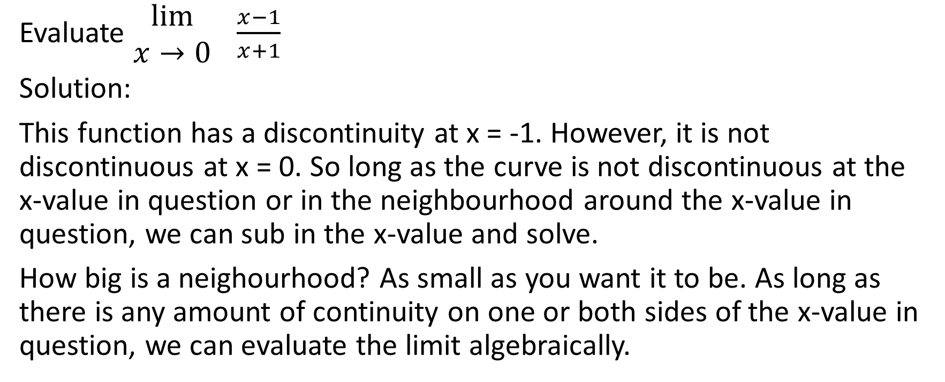
Evaluate $\begin{matrix}lim⁡ \\ x→0\end{matrix} \frac{x−1}{x+1}$
Solution:
This function has a discontinuity at x = -1. However, it is not discontinuous at x = 0. So long as the curve is not discontinuous at the x-value in question or in the neighbourhood around the x-value in question, we can sub in the x-value and solve.
How big is a neighourhood? As small as you want it to be. As long as there is any amount of continuity on one or both sides of the x-value in question, we can evaluate the limit algebraically.

Slide 17

Evaluate $\begin{matrix}lim⁡ \\ x→0\end{matrix} \frac{x−1}{x+1}$
Solution:
$\begin{matrix}lim⁡ \\ x→0\end{matrix} \frac{x−1}{x+1}=\frac{0−1}{0+1}=\frac{−1}{1}=−1$

Slide 18

Example
Evaluate $\begin{matrix}lim⁡ \\ x→3\end{matrix} \frac{\sqrt{x−1} − \sqrt{x+1}}{\sqrt{x−3} − \sqrt{x+3}}$

Slide 19
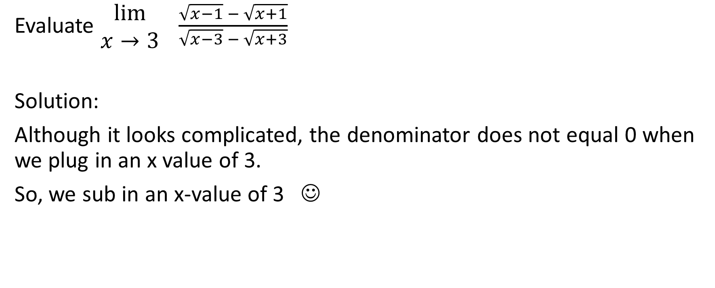
Evaluate $\begin{matrix}lim⁡ \\ x→3\end{matrix} \frac{\sqrt{x−1} − \sqrt{x+1}}{\sqrt{x−3} − \sqrt{x+3}}$
Solution:
Although it looks complicated, the denominator does not equal 0 when we plug in an x value of 3.
So, we sub in an x-value of 3 ☺

Slide 20
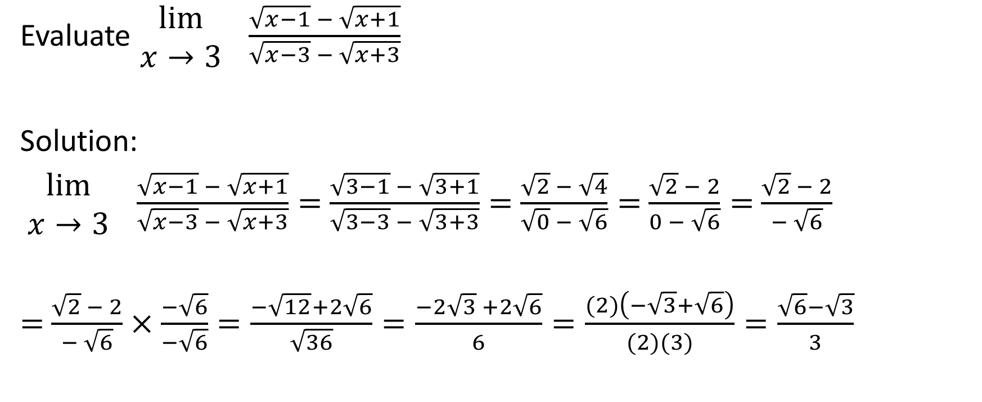
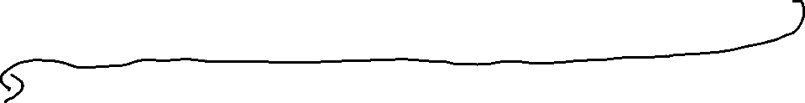
Evaluate $\begin{matrix}lim⁡ \\ x→3\end{matrix} \frac{\sqrt{x−1} − \sqrt{x+1}}{\sqrt{x−3} − \sqrt{x+3}}$
Solution:
$\begin{matrix}lim⁡ \\ x→3\end{matrix} \frac{\sqrt{x−1} − \sqrt{x+1}}{\sqrt{x−3} − \sqrt{x+3}}=$ $\frac{\sqrt{3−1} − \sqrt{3+1}}{\sqrt{3−3} − \sqrt{3+3}}=$ $\frac{\sqrt{2} − \sqrt{4}}{\sqrt{0} − \sqrt{6}}=$ $\frac{\sqrt{2} − 2}{0 − \sqrt{6}}=$ $\frac{\sqrt{2} − 2}{− \sqrt{6}}$
$=$ $\frac{\sqrt{2} − 2}{− \sqrt{6}}×\frac{−\sqrt{6}}{−\sqrt{6}}=\frac{−\sqrt{12}+2\sqrt{6}}{\sqrt{36}}=\frac{−2\sqrt{3} +2\sqrt{6}}{6}=\frac{(2)\left(−\sqrt{3}+\sqrt{6}\right)}{(2)(3)}=\frac{\sqrt{6}−\sqrt{3}}{3}$

Slide 21
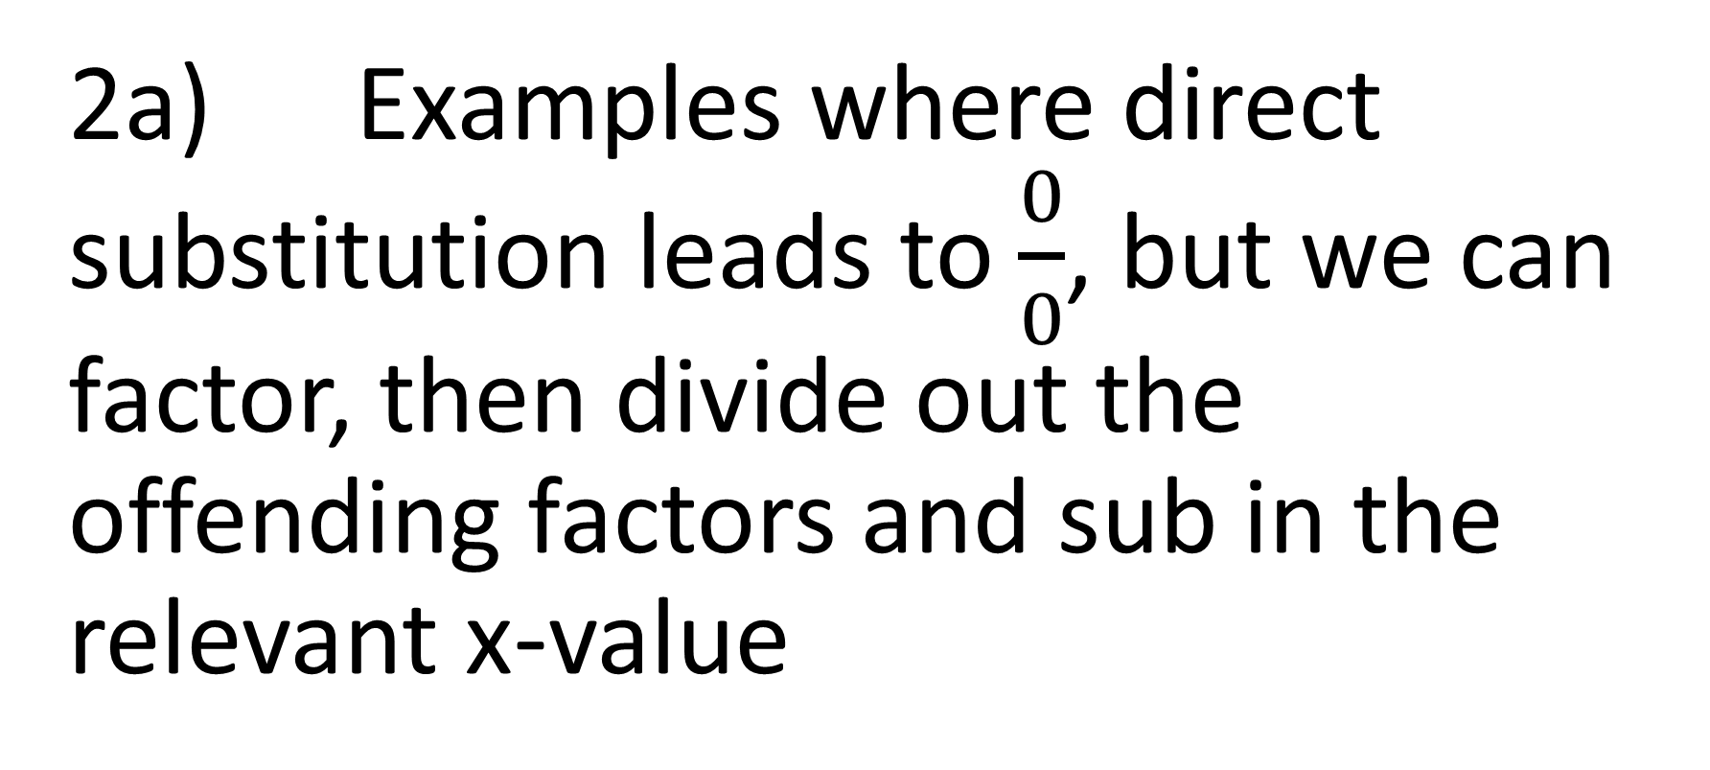
2a) Examples where direct substitution leads to $\frac{0}{0}$, but we can factor, then divide out the offending factors and sub in the relevant x-value

Slide 22

Example
Evaluate
$\begin{matrix}lim⁡ \\ x→3\end{matrix} \frac{x−3}{x^{2}+x−12}$

Slide 23
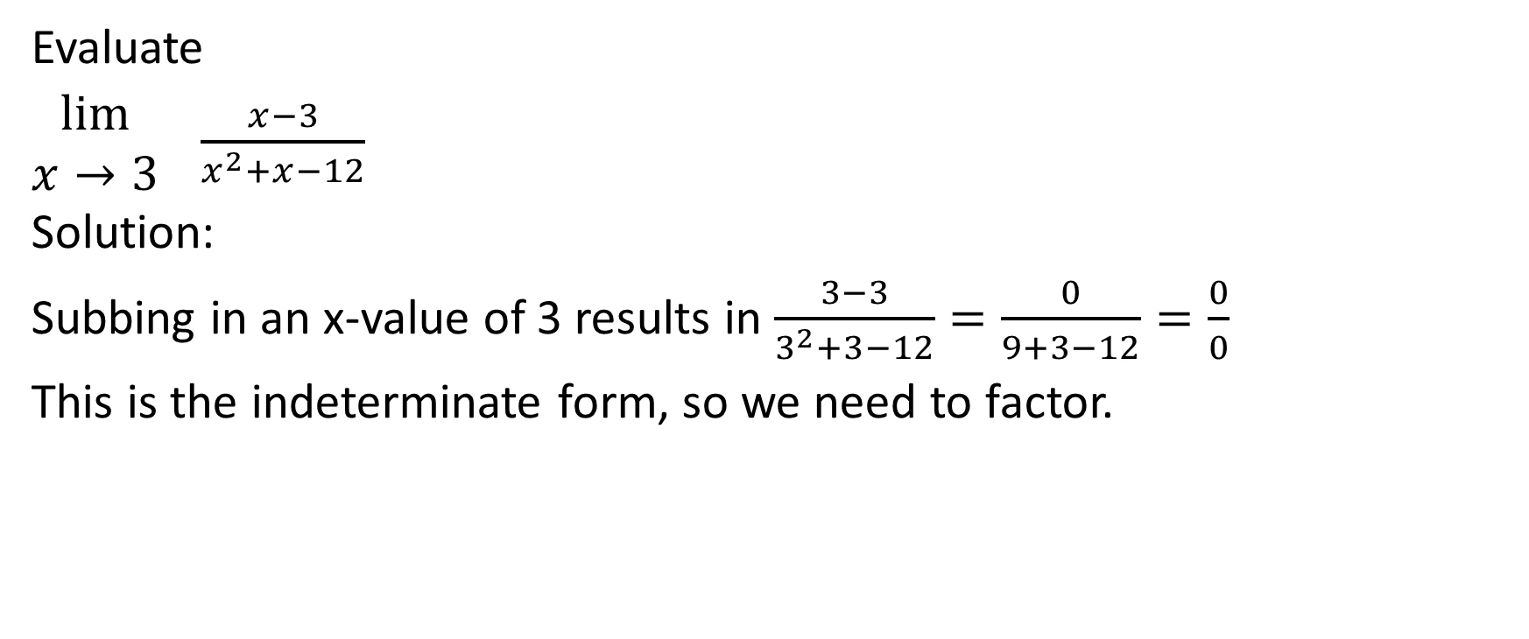
Evaluate
$\begin{matrix}lim⁡ \\ x→3\end{matrix} \frac{x−3}{x^{2}+x−12}$
Solution:
Subbing in an x-value of 3 results in $\frac{3−3}{3^{2}+3−12}=\frac{0}{9+3−12}=\frac{0}{0}$
This is the indeterminate form, so we need to factor.

Slide 24

Evaluate
$\begin{matrix}lim⁡ \\ x→3\end{matrix} \frac{x−3}{x^{2}+x−12}$
Solution:
$\begin{matrix}lim⁡ \\ x→3\end{matrix} \frac{x−3}{x^{2}+x−12}$
$=\begin{matrix}lim⁡ \\ x→3\end{matrix} \frac{x−3}{(x+4)(x−3)}$

Slide 25


Evaluate
$\begin{matrix}lim⁡ \\ x→3\end{matrix} \frac{x−3}{x^{2}+x−12}$
Solution:
$\begin{matrix}lim⁡ \\ x→3\end{matrix} \frac{x−3}{x^{2}+x−12}$
$=\begin{matrix}lim⁡ \\ x→3\end{matrix} \frac{x−3}{(x+4)(x−3)}$
$=\begin{matrix}lim⁡ \\ x→3\end{matrix} \frac{1}{x+4}$

Slide 26
Evaluate
$\begin{matrix}lim⁡ \\ x→3\end{matrix} \frac{x−3}{x^{2}+x−12}$
Solution:
$\begin{matrix}lim⁡ \\ x→3\end{matrix} \frac{x−3}{x^{2}+x−12}$
$=\begin{matrix}lim⁡ \\ x→3\end{matrix} \frac{x−3}{(x+4)(x−3)}$
$=\begin{matrix}lim⁡ \\ x→3\end{matrix} \frac{1}{x+4}$
Now, we can directly sub in an x-value of 3 and get a value that is defined.
Note that after we sub in the x-value of 3, there will be no more x’s in the expression, so there will be no more need for the limit notation on the left. Until this point, however, we need to keep putting the limit notation on the left.
In short, as long as there are x’s in the expression, we need to keep the limit notation in the solution.

Slide 27
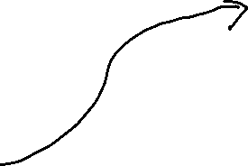
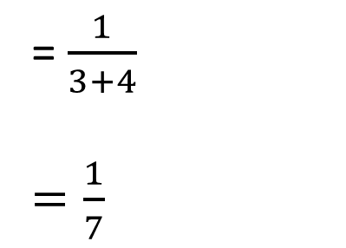
Evaluate
$\begin{matrix}lim⁡ \\ x→3\end{matrix} \frac{x−3}{x^{2}+x−12}$
Solution:
$\begin{matrix}lim⁡ \\ x→3\end{matrix} \frac{x−3}{x^{2}+x−12}$
$=\begin{matrix}lim⁡ \\ x→3\end{matrix} \frac{x−3}{(x+4)(x−3)}$
$=\begin{matrix}lim⁡ \\ x→3\end{matrix} \frac{1}{x+4}$
= $\frac{1}{3+4}$
$=\frac{1}{7}$

Slide 28

Example
Evaluate
$\begin{matrix}lim⁡ \\ h→0\end{matrix} \frac{{(2+h)}^{3}−8}{h}$

Slide 29

Evaluate
$\begin{matrix}lim⁡ \\ h→0\end{matrix} \frac{{(2+h)}^{3}−8}{h}$
Solution:
Subbing in an h value of 0 will create the indeterminate form of $\frac{0}{0}$

Slide 30


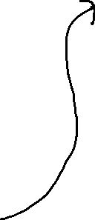
Evaluate
$\begin{matrix}lim⁡ \\ h→0\end{matrix} \frac{{(2+h)}^{3}−8}{h}$
Solution:
Method #1: Expand the numerator
$\begin{matrix}lim⁡ \\ h→0\end{matrix} \frac{{(2+h)}^{3}−8}{h}$
$=\begin{matrix}lim⁡ \\ h→0\end{matrix} \frac{(2+h)(2+h)(2+h)−8}{h}$
=$\begin{matrix}lim⁡ \\ h→0\end{matrix} \frac{\left(4+4h+h^{2}\right)\left(2+h\right)−8}{h}$
=$\begin{matrix}lim⁡ \\ h→0\end{matrix} \frac{8+12h+6h^{2}+h^{3}−8}{h}$
=$\begin{matrix}lim⁡ \\ h→0\end{matrix} \frac{12h+6h^{2}+h^{3}}{h}$
Now, factor the numerator

Slide 31

Evaluate
$\begin{matrix}lim⁡ \\ h→0\end{matrix} \frac{{(2+h)}^{3}−8}{h}$
Solution:
$\begin{matrix}lim⁡ \\ h→0\end{matrix} \frac{12h+6h^{2}+h^{3}}{h}$
$=\begin{matrix}lim⁡ \\ h→0\end{matrix} \frac{h(12+6h+h^{2})}{h}$

Slide 32


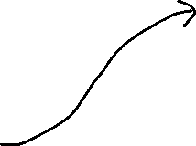
Evaluate
$\begin{matrix}lim⁡ \\ h→0\end{matrix} \frac{{(2+h)}^{3}−8}{h}$
Solution:
$\begin{matrix}lim⁡ \\ h→0\end{matrix} \frac{12h+6h^{2}+h^{3}}{h}$
$=\begin{matrix}lim⁡ \\ h→0\end{matrix} \frac{h(12+6h+h^{2})}{h}$
$=\begin{matrix}lim⁡ \\ h→0\end{matrix} 12+6h+h^{2}$
$=12+6\left(0\right)+{(0)}^{2}$
$=12+0+0$
$=12$

Slide 33




Evaluate
$\begin{matrix}lim⁡ \\ h→0\end{matrix} \frac{{(2+h)}^{3}−8}{h}$
Solution:
Method #2: Factor the numerator
as a Difference of Cubes
Let $w=2+h$
$\begin{matrix}lim⁡ \\ h→0\end{matrix} \frac{{(2+h)}^{3}−8}{h}$ = $\begin{matrix}lim⁡ \\ h→0\end{matrix} \frac{w^{3}−8}{h}$
=$\begin{matrix}lim⁡ \\ h→0\end{matrix} \frac{(w−2)(w^{2}+2w+4)}{h}$
Sub in w = 2+h to the numerator
=$\begin{matrix}lim⁡ \\ h→0\end{matrix} \frac{(2+h−2)(w^{2}+2w+4)}{h}$
=$\begin{matrix}lim⁡ \\ h→0\end{matrix} \frac{(h)(w^{2}+2w+4)}{h}$

Slide 34


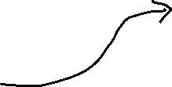
Evaluate
$\begin{matrix}lim⁡ \\ h→0\end{matrix} \frac{{(2+h)}^{3}−8}{h}$
Solution:
=$\begin{matrix}lim⁡ \\ h→0\end{matrix} w^{2}+2w+4$
=$\begin{matrix}lim⁡ \\ h→0\end{matrix} {(2+h)}^{2}+2(2+h)+4$
=${(2+0)}^{2}+2(2+0)+4$
$={(2)}^{2}+2\left(2\right)+4$
$=4+4+4$
$=12$

Slide 35

Example
Evaluate
$\begin{matrix}lim⁡ \\ x→−2\end{matrix} \frac{x^{4}−16}{x+2}$

Slide 36

Evaluate
$\begin{matrix}lim⁡ \\ x→−2\end{matrix} \frac{x^{4}−16}{x+2}$
Solution:
Subbing in an x value of -2 will give 0 over 0, the indeterminate form. So, let’s try factoring instead.

Slide 37



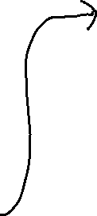
Evaluate
$\begin{matrix}lim⁡ \\ x→−2\end{matrix} \frac{x^{4}−16}{x+2}$
Solution:
$\begin{matrix}lim⁡ \\ x→−2\end{matrix} \frac{x^{4}−16}{x+2}$
$=\begin{matrix}lim⁡ \\ x→−2\end{matrix} \frac{(x^{2}−4)(x^{2}+4)}{x+2}$
$=\begin{matrix}lim⁡ \\ x→−2\end{matrix} \frac{(x−2)(x+2)(x^{2}+4)}{x+2}$
$=\begin{matrix}lim⁡ \\ x→−2\end{matrix} \left(x−2\right)\left(x^{2}+4\right)$
$=\left(−2−2\right)\left[{(−2)}^{2}+4\right]$
$=\left(−4\right)\left[4+4\right]$
$=(−4)(8)$
$=−32$

Slide 38

Example
Evaluate
$\begin{matrix}lim⁡ \\ x→25\end{matrix} \frac{x−25}{\sqrt{x}−5}$

Slide 39
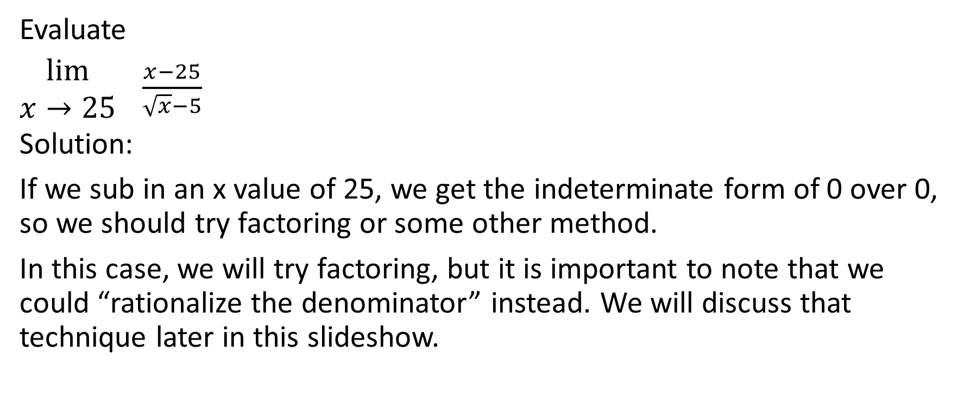
Evaluate
$\begin{matrix}lim⁡ \\ x→25\end{matrix} \frac{x−25}{\sqrt{x}−5}$
Solution:
If we sub in an x value of 25, we get the indeterminate form of 0 over 0, so we should try factoring or some other method.
In this case, we will try factoring, but it is important to note that we could “rationalize the denominator” instead. We will discuss that technique later in this slideshow.

Slide 40
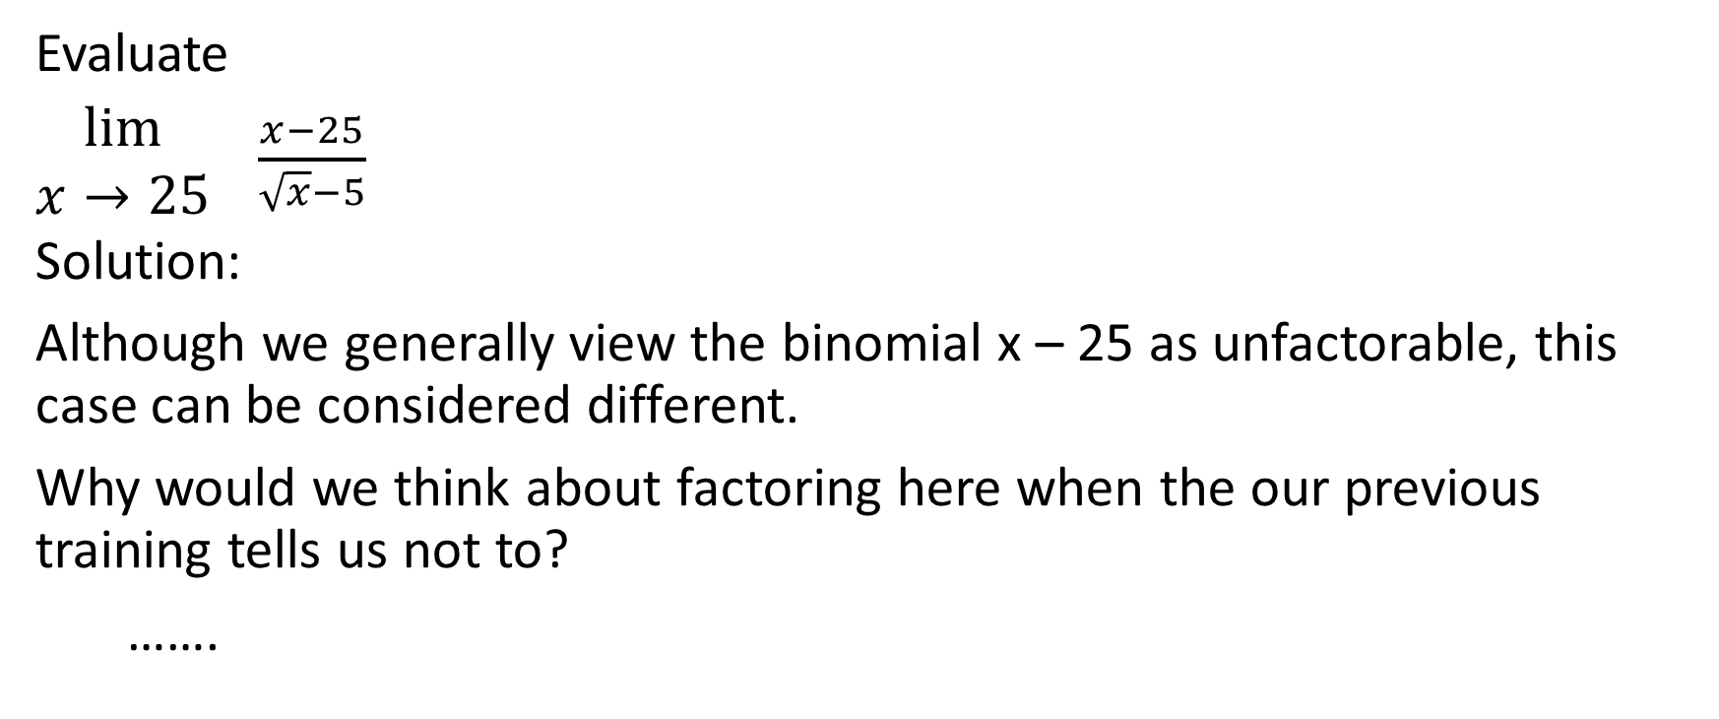
Evaluate
$\begin{matrix}lim⁡ \\ x→25\end{matrix} \frac{x−25}{\sqrt{x}−5}$
Solution:
Although we generally view the binomial x – 25 as unfactorable, this case can be considered different.
Why would we think about factoring here when the our previous training tells us not to?
…….

Slide 41
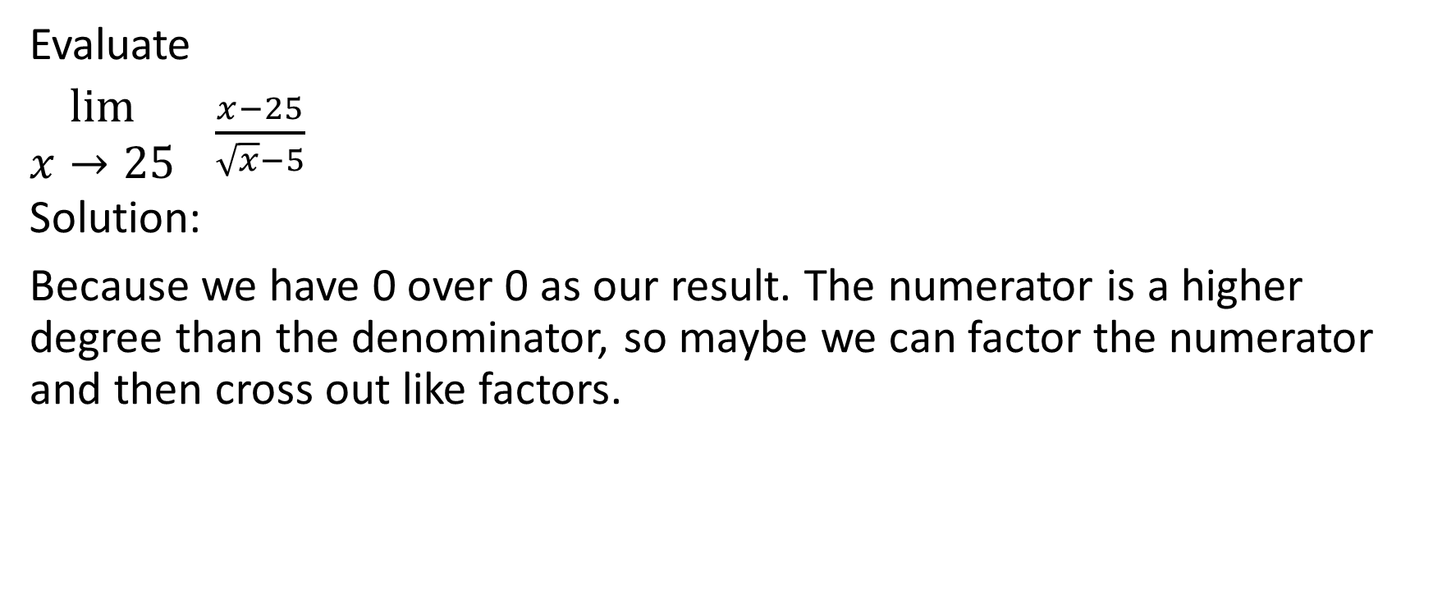
Evaluate
$\begin{matrix}lim⁡ \\ x→25\end{matrix} \frac{x−25}{\sqrt{x}−5}$
Solution:
Because we have 0 over 0 as our result. The numerator is a higher degree than the denominator, so maybe we can factor the numerator and then cross out like factors.

Slide 42


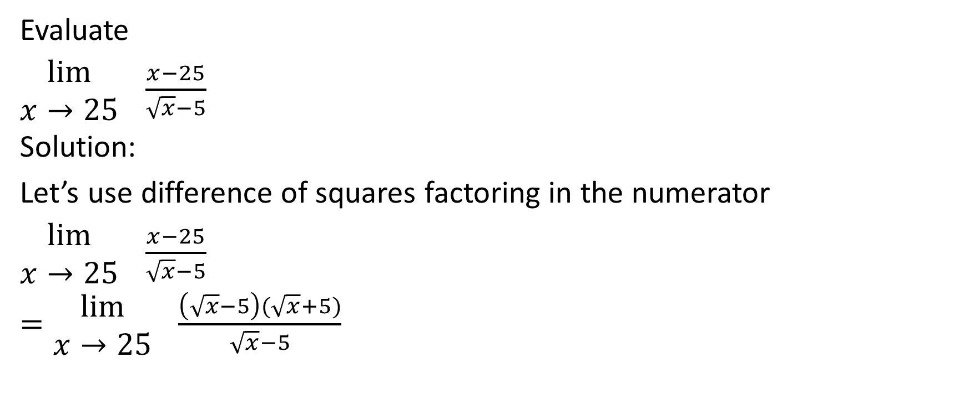

Evaluate
$\begin{matrix}lim⁡ \\ x→25\end{matrix} \frac{x−25}{\sqrt{x}−5}$
Solution:
Let’s use difference of squares factoring in the numerator
$\begin{matrix}lim⁡ \\ x→25\end{matrix} \frac{x−25}{\sqrt{x}−5}$
$=\begin{matrix}lim⁡ \\ x→25\end{matrix} \frac{\left(\sqrt{x}−5\right)(\sqrt{x}+5)}{\sqrt{x}−5}$
$=\begin{matrix}lim⁡ \\ x→25\end{matrix} \sqrt{x}+5$
$=\sqrt{25}+5$
$=5+5$
$=10$

Slide 43

Example
Evaluate
$\begin{matrix}lim⁡ \\ x→2\end{matrix} \frac{x^{2}−4}{x^{3}−8}$

Slide 44

Evaluate
$\begin{matrix}lim⁡ \\ x→2\end{matrix} \frac{x^{2}−4}{x^{3}−8}$
Solution:
Plugging in an x value of 2 gives us the indeterminate form of 0 over 0. So we can try factoring instead. Let’s use difference of squares in the numerator and difference of cubes in the denominator.

Slide 45




Evaluate
$\begin{matrix}lim⁡ \\ x→2\end{matrix} \frac{x^{2}−4}{x^{3}−8}$
Solution:
$\begin{matrix}lim⁡ \\ x→2\end{matrix} \frac{x^{2}−4}{x^{3}−8}$
$=\begin{matrix}lim⁡ \\ x→2\end{matrix} \frac{(x−2)(x+2)}{(x−2)(x^{2}+2x+4)}$
$=\begin{matrix}lim⁡ \\ x→2\end{matrix} \frac{x+2}{x^{2}+2x+4}$
$= \frac{2+2}{{(2)}^{2}+2(2)+4}$
$= \frac{4}{4+4+4}$
$= \frac{4}{12}$
$= \frac{1}{3}$

Slide 46
And now, for something a little bit different …

Slide 47

Difference of nth Powers Factoring
If n is a positive integer, then
$a^{n}−b^{n}=\left(a−b\right)\left(a^{n−1}+a^{n−2}b+a^{n−3}b^{2}+…+ab^{n−2}+b^{n−1}\right)$
For example,
$a^{2}−b^{2}=\left(a−b\right)\left(a+b\right)$
$a^{3}−b^{3}=\left(a−b\right)\left(a^{2}+ab+b^{2}\right)$
$a^{4}−b^{4}=\left(a−b\right)\left(a^{3}+a^{2}b+ab^{2}+b^{3}\right)$
$a^{5}−b^{5}=\left(a−b\right)\left(a^{4}+a^{3}b+a^{2}b^{2}+ab^{3}+b^{4}\right)$
$a^{6}−b^{6}=\left(a−b\right)\left(a^{5}+a^{4}b+a^{3}b^{2}+a^{2}b^{3}+ab^{4}+b^{5}\right)$

Slide 48

Sum of nth Powers Factoring (works when n is odd)
If n is an odd positive integer, then
$$a^{n}+b^{n}=\left(a+b\right)\left(a^{n−1}−a^{n−2}b+a^{n−3}b^{2}−…−ab^{n−2}+b^{n−1}\right)$$
For example
$a^{3}+b^{3}=\left(a+b\right)\left(a^{2}−ab+b^{2}\right)$
$a^{5}+b^{5}=\left(a+b\right)\left(a^{4}−a^{3}b+a^{2}b^{2}−ab^{3}+b^{4}\right)$
$a^{7}+b^{7}=\left(a+b\right)\left(a^{6}−a^{5}b+a^{4}b^{2}−a^{3}b^{3}+a^{2}b^{4}−ab^{5}+b^{6}\right)$
This does not work if n is even

Slide 49

Sum of nth powers factoring is really just an extension of difference of nth powers factoring.
For example, consider $a^{5}+b^{5}$
$a^{5}+b^{5}$
$=a^{5}−{(−b)}^{5}$
$=\left[a−(−b)\right]\left[a^{4}+a^{3}\left(−b\right)+a^{2}{(−b)}^{2}+a{(−b)}^{3}+{(−b)}^{4}\right]$
$=\left[a+b\right]\left[a^{4}+\left(−a^{3}b\right)+a^{2}b^{2}+\left(−ab^{3}\right)+b^{4}\right]$
$=\left(a+b\right)\left(a^{4}−a^{3}b+a^{2}b^{2}−ab^{3}+b^{4}\right)$

Slide 50
And now, back to our lesson on limits …

Slide 51

Example
Evaluate
$\begin{matrix}lim⁡ \\ x→3\end{matrix} \frac{{2x}^{4}−162}{{−x}^{5}+243}$

Slide 52

Evaluate
$\begin{matrix}lim⁡ \\ x→3\end{matrix} \frac{{2x}^{4}−162}{{−x}^{5}+243}$
Solution:
Let’s common factor first
$\begin{matrix}lim⁡ \\ x→3\end{matrix} \frac{{2x}^{4}−162}{{−x}^{5}+243}$
$=$ $\begin{matrix}lim⁡ \\ x→3\end{matrix} \frac{{2(x}^{4}−81)}{{−1(x}^{5}−243)}$

Slide 53

We can use difference of 4th powers in the numerator and difference of 5th powers in the denominator.
The numerator has a factor of $x^{4}−3^{4}$ and the denominator has a factor of $x^{5}−3^{5}$
Evaluate
$\begin{matrix}lim⁡ \\ x→3\end{matrix} \frac{{2x}^{4}−162}{{−x}^{5}+243}$
Solution:
Let’s common factor first
$\begin{matrix}lim⁡ \\ x→3\end{matrix} \frac{{2x}^{4}−162}{{−x}^{5}+243}$
$=$ $\begin{matrix}lim⁡ \\ x→3\end{matrix} \frac{{2(x}^{4}−81)}{{−1(x}^{5}−243)}$

Slide 54



We can use difference of 4th powers in the numerator and difference of 5th powers in the denominator.
The numerator has a factor of $x^{4}−3^{4}$ and the denominator has a factor of $x^{5}−3^{5}$
$=$ $\begin{matrix}lim⁡ \\ x→3\end{matrix} \frac{{2(x−3)\left[x^{3}+x^{2}\left(3\right)+x{\left(3\right)}^{2}+{(3)}^{3}\right]}^{}}{{−1(x−3)\left[x^{4}+x^{3}\left(3\right)+x^{2}{(3)}^{2}+x{(3)}^{3}+{(3)}^{4}\right]}^{}}$
Evaluate
$\begin{matrix}lim⁡ \\ x→3\end{matrix} \frac{{2x}^{4}−162}{{−x}^{5}+243}$
Solution:
Let’s common factor first
$\begin{matrix}lim⁡ \\ x→3\end{matrix} \frac{{2x}^{4}−162}{{−x}^{5}+243}$
$=$ $\begin{matrix}lim⁡ \\ x→3\end{matrix} \frac{{2(x}^{4}−81)}{{−1(x}^{5}−243)}$

Slide 55



Evaluate
$\begin{matrix}lim⁡ \\ x→3\end{matrix} \frac{{2x}^{4}−162}{{−x}^{5}+243}$
Solution:
$=$ $\begin{matrix}lim⁡ \\ x→3\end{matrix} \frac{{2\left[x^{3}+x^{2}\left(3\right)+x{\left(3\right)}^{2}+{(3)}^{3}\right]}^{}}{{−1\left[x^{4}+x^{3}\left(3\right)+x^{2}{(3)}^{2}+x{(3)}^{3}+{(3)}^{4}\right]}^{}}$
$=$ $\frac{{2\left[{(3)}^{3}+{(3)}^{2}\left(3\right)+(3){\left(3\right)}^{2}+{(3)}^{3}\right]}^{}}{{−1\left[{(3)}^{4}+{(3)}^{3}\left(3\right)+{(3)}^{2}{(3)}^{2}+(3){(3)}^{3}+{(3)}^{4}\right]}^{}}$
$=$ $\frac{{2\left[27+(9)(3)+(3)(9) +27\right]}^{}}{{−1\left[81+(27)\left(3\right)+(9)(9)+(3)(27) +81\right]}^{}}$
$$=\frac{2(27+27+27+27)}{−1(81+81+81+81+81)}$$
$=\frac{2(108)}{−1(405)}$
$=\frac{216}{−405}$
$=\frac{−8}{15}$

Slide 56

Example
Evaluate
$\begin{matrix}lim⁡ \\ x→−2\end{matrix} \frac{x^{7}+128}{10x+20}$

Slide 57

Evaluate
$\begin{matrix}lim⁡ \\ x→−2\end{matrix} \frac{x^{7}+128}{10x+20}$
Solution:
If we plug in an x value of -2 we get the indeterminate form of 0 over 0.
So we need to factor. We can’t common factor the numerator but we can common factor the denominator. We’ll use sum of 7th powers factoring in the numerator and common factoring in the denominator

Slide 58


Evaluate
$\begin{matrix}lim⁡ \\ x→−2\end{matrix} \frac{x^{7}+128}{10x+20}$
Solution:
$\begin{matrix}lim⁡ \\ x→−2\end{matrix} \frac{x^{7}+128}{10x+20}$
Our sum of 7th powers in the numerator is $a^{7}+b^{7}$ where $a=x$ and $b=2$

Slide 59

Evaluate
$\begin{matrix}lim⁡ \\ x→−2\end{matrix} \frac{x^{7}+128}{10x+20}$
Solution:
$\begin{matrix}lim⁡ \\ x→−2\end{matrix} \frac{x^{7}+128}{10x+20}$
$=\begin{matrix}lim⁡ \\ x→−2\end{matrix} \frac{\left(x+2\right)\left[x^{6}−x^{5}\left(2\right)+x^{4}{\left(2\right)}^{2}−x^{3}{\left(2\right)}^{3}+x^{2}{\left(2\right)}^{4}−x{(2)}^{5}+{(2)}^{6}\right]}{10(x+2)}$
$=\begin{matrix}lim⁡ \\ x→−2\end{matrix} \frac{\left[x^{6}−{2x}^{5}+{4x}^{4}−{8x}^{3}+{16x}^{2}−32x+64\right]}{10}$
Our sum of 7th powers in the numerator is $a^{7}+b^{7}$ where $a=x$ and $b=2$

Slide 60

Evaluate
$\begin{matrix}lim⁡ \\ x→−2\end{matrix} \frac{x^{7}+128}{10x+20}$
Solution:
$= \frac{\left[{(−2)}^{6}−2{\left(−2\right)}^{5}+{4\left(−2\right)}^{4}−{8\left(−2\right)}^{3}+{16\left(−2\right)}^{2}−32(−2)+64\right]}{10}$
$=\frac{64−2\left(−32\right)+4\left(16\right)−8\left(−8\right)+16\left(4\right)−32\left(−2\right)+64}{10}$
$=\frac{64+64+64+64+64+64+64}{10}=\frac{448}{10}=\frac{224}{5}$

Slide 61

2b) Examples where direct substitution leads to $\frac{0}{0}$, but we can rationalize the numerator and/or denominator, then perhaps factor, then cancel, then substitute.

Slide 62

Example
Evaluate
$\begin{matrix}lim⁡ \\ h→0\end{matrix} \frac{\sqrt{16+h}−4}{h}$

Slide 63

Evaluate
$\begin{matrix}lim⁡ \\ h→0\end{matrix} \frac{\sqrt{16+h}−4}{h}$
Solution:
Directly substituting in an h value of 0 leads to the indeterminate form of 0 over 0. We can’t factor. However, when we have a binomial with a square root like we do in this case, we can often multiply numerator and denominator by the conjugate of that binomial.

Slide 64

Evaluate
$\begin{matrix}lim⁡ \\ h→0\end{matrix} \frac{\sqrt{16+h}−4}{h}$
Solution:
To determine the conjugate of a binomial, we leave both terms the same and we change the operator between the terms from + to – or from – to +.
This effectively creates a difference of squares, and often has the desired effect of allowing us to evaluate the limit.

Slide 65

Evaluate
$\begin{matrix}lim⁡ \\ h→0\end{matrix} \frac{\sqrt{16+h}−4}{h}$
Solution:
The conjugate of $\sqrt{16+h}−4$ is $\sqrt{16+h}+4$.
Hence, we will multiply numerator and denominator by $\sqrt{16+h}+4$
In other words, we will multiply the expression by $\frac{\sqrt{16+h}+4}{\sqrt{16+h}+4}$

Slide 66

Evaluate
$\begin{matrix}lim⁡ \\ h→0\end{matrix} \frac{\sqrt{16+h}−4}{h}$
Solution:
$\begin{matrix}lim⁡ \\ h→0\end{matrix} \frac{\sqrt{16+h}−4}{h}$
$=\begin{matrix}lim⁡ \\ h→0\end{matrix} \frac{\sqrt{16+h}−4}{h}×\frac{\sqrt{16+h}+4}{\sqrt{16+h}+4}$
$=$ $\begin{matrix}lim⁡ \\ h→0\end{matrix} \frac{(\sqrt{16+h}−4)(\sqrt{16+h}+4)}{h(\sqrt{16+h}+4)}$

Slide 67

Evaluate
$\begin{matrix}lim⁡ \\ h→0\end{matrix} \frac{\sqrt{16+h}−4}{h}$
Solution:
$\begin{matrix}lim⁡ \\ h→0\end{matrix} \frac{\sqrt{16+h}−4}{h}$
$=\begin{matrix}lim⁡ \\ h→0\end{matrix} \frac{\sqrt{16+h}−4}{h}×\frac{\sqrt{16+h}+4}{\sqrt{16+h}+4}$
$=$ $\begin{matrix}lim⁡ \\ h→0\end{matrix} \frac{(\sqrt{16+h}−4)(\sqrt{16+h}+4)}{h(\sqrt{16+h}+4)}$

Slide 68

Evaluate
$\begin{matrix}lim⁡ \\ h→0\end{matrix} \frac{\sqrt{16+h}−4}{h}$
Solution:
$=$ $\begin{matrix}lim⁡ \\ h→0\end{matrix} \frac{{\left(\sqrt{16+h}\right)}^{2} + 4\sqrt{16+h} − 4\sqrt{16+h} − 16}{h(\sqrt{16+h}+4)}$

Slide 69



Evaluate
$\begin{matrix}lim⁡ \\ h→0\end{matrix} \frac{\sqrt{16+h}−4}{h}$
Solution:
$=$ $\begin{matrix}lim⁡ \\ h→0\end{matrix} \frac{{\left(\sqrt{16+h}\right)}^{2} + 4\sqrt{16+h} − 4\sqrt{16+h} − 16}{h(\sqrt{16+h}+4)}$
${\left(\sqrt{16+h}\right)}^{2}=16+h$

Slide 70


Evaluate
$\begin{matrix}lim⁡ \\ h→0\end{matrix} \frac{\sqrt{16+h}−4}{h}$
Solution:
$=$ $\begin{matrix}lim⁡ \\ h→0\end{matrix} \frac{{\left(\sqrt{16+h}\right)}^{2} + 4\sqrt{16+h} − 4\sqrt{16+h} − 16}{h(\sqrt{16+h}+4)}$
These two middle terms cancel out, just like they do in a difference of squares situation

Slide 71


Evaluate
$\begin{matrix}lim⁡ \\ h→0\end{matrix} \frac{\sqrt{16+h}−4}{h}$
Solution:
$=$ $\begin{matrix}lim⁡ \\ h→0\end{matrix} \frac{{\left(\sqrt{16+h}\right)}^{2} + 4\sqrt{16+h} − 4\sqrt{16+h} − 16}{h(\sqrt{16+h}+4)}$
Let’s not expand the denominator. Why not? Because our problem is that we get values of 0 in both the numerator and denominator. Leave the h alone as a distinct factor of the denominator because we’re trying to generate h as a factor of the numerator so that we can then cancel them out, sub in h = 0 and evaluate.

Slide 72

Evaluate
$\begin{matrix}lim⁡ \\ h→0\end{matrix} \frac{\sqrt{16+h}−4}{h}$
Solution:
$=$ $\begin{matrix}lim⁡ \\ h→0\end{matrix} \frac{{\left(\sqrt{16+h}\right)}^{2} + 4\sqrt{16+h} − 4\sqrt{16+h} − 16}{h(\sqrt{16+h}+4)}$
$=\begin{matrix}lim⁡ \\ h→0\end{matrix} \frac{16+h−16}{h\left(\sqrt{16+h}+4\right)}$
$=\begin{matrix}lim⁡ \\ h→0\end{matrix} \frac{h}{h\left(\sqrt{16+h}+4\right)}$

Slide 73

Evaluate
$\begin{matrix}lim⁡ \\ h→0\end{matrix} \frac{\sqrt{16+h}−4}{h}$
Solution:
$=\begin{matrix}lim⁡ \\ h→0\end{matrix} \frac{1}{\left(\sqrt{16+h}+4\right)}$
$= \frac{1}{\left(\sqrt{16+0}+4\right)}$
$= \frac{1}{\left(\sqrt{16}+4\right)}=\frac{1}{4+4}=\frac{1}{8}$

Slide 74

Example
Evaluate
$\begin{matrix}lim⁡ \\ x→2\end{matrix} \frac{x−2}{\sqrt{27−x} − 5}$

Slide 75

Evaluate
$\begin{matrix}lim⁡ \\ x→2\end{matrix} \frac{x−2}{\sqrt{27−x} − 5}$
Solution:
Subbing in an x value of 2 directly leads to the indeterminate form of 0 over 0.
Let’s multiply numerator and denominator by the conjugate of the denominator. The conjugate of $\sqrt{27−x} −5$ is $\sqrt{27−x}+5$

Slide 76

Evaluate
$\begin{matrix}lim⁡ \\ x→2\end{matrix} \frac{x−2}{\sqrt{27−x} − 5}$
Solution:
$\begin{matrix}lim⁡ \\ x→2\end{matrix} \frac{x−2}{\sqrt{27−x} − 5}$
$=\begin{matrix}lim⁡ \\ x→2\end{matrix} \frac{x−2}{\sqrt{27−x} − 5}×\frac{\sqrt{27−x} + 5}{\sqrt{27−x} +5}$
$=\begin{matrix}lim⁡ \\ x→2\end{matrix} \frac{(x−2)(\sqrt{27−x}+5)}{(\sqrt{27−x} − 5)(\sqrt{27−x} + 5)}$

Slide 77

Evaluate
$\begin{matrix}lim⁡ \\ x→2\end{matrix} \frac{x−2}{\sqrt{27−x} − 5}$
Solution:
$\begin{matrix}lim⁡ \\ x→2\end{matrix} \frac{x−2}{\sqrt{27−x} − 5}$
$=\begin{matrix}lim⁡ \\ x→2\end{matrix} \frac{x−2}{\sqrt{27−x} − 5}×\frac{\sqrt{27−x} + 5}{\sqrt{27−x} +5}$
$=\begin{matrix}lim⁡ \\ x→2\end{matrix} \frac{(x−2)(\sqrt{27−x}+5)}{(\sqrt{27−x} − 5)(\sqrt{27−x} + 5)}$

Slide 78

Evaluate
$\begin{matrix}lim⁡ \\ x→2\end{matrix} \frac{x−2}{\sqrt{27−x} − 5}$
Solution:
$=\begin{matrix}lim⁡ \\ x→2\end{matrix} \frac{(x−2)(\sqrt{27−x}+5)}{{(\sqrt{27−x})}^{2} + 5\sqrt{27−x} − 5\sqrt{27−x} − 25}$

Slide 79


Evaluate
$\begin{matrix}lim⁡ \\ x→2\end{matrix} \frac{x−2}{\sqrt{27−x} − 5}$
Solution:
$=\begin{matrix}lim⁡ \\ x→2\end{matrix} \frac{(x−2)(\sqrt{27−x}+5)}{{(\sqrt{27−x})}^{2} + 5\sqrt{27−x} − 5\sqrt{27−x} − 25}$
${(\sqrt{27−x})}^{2}=27−x$

Slide 80


Evaluate
$\begin{matrix}lim⁡ \\ x→2\end{matrix} \frac{x−2}{\sqrt{27−x} − 5}$
Solution:
$=\begin{matrix}lim⁡ \\ x→2\end{matrix} \frac{(x−2)(\sqrt{27−x}+5)}{{(\sqrt{27−x})}^{2} + 5\sqrt{27−x} − 5\sqrt{27−x} − 25}$
The two middle terms in the denominator cancel out

Slide 81


Evaluate
$\begin{matrix}lim⁡ \\ x→2\end{matrix} \frac{x−2}{\sqrt{27−x} − 5}$
Solution:
$=\begin{matrix}lim⁡ \\ x→2\end{matrix} \frac{(x−2)(\sqrt{27−x}+5)}{{(\sqrt{27−x})}^{2} + 5\sqrt{27−x} − 5\sqrt{27−x} − 25}$
Let’s not expand the numerator. Hopefully our efforts will generate a factor of (x – 2) in the denominator, which would allow us to cross it out of the numerator and the denominator and then allow us to sub in an x value of 2

Slide 82

Evaluate
$\begin{matrix}lim⁡ \\ x→2\end{matrix} \frac{x−2}{\sqrt{27−x} − 5}$
Solution:
$=\begin{matrix}lim⁡ \\ x→2\end{matrix} \frac{(x−2)(\sqrt{27−x}+5)}{{(\sqrt{27−x})}^{2} + 5\sqrt{27−x} − 5\sqrt{27−x} − 25}$
$=\begin{matrix}lim⁡ \\ x→2\end{matrix} \frac{(x−2)(\sqrt{27−x}+5)}{27−x − 25}$
$=\begin{matrix}lim⁡ \\ x→2\end{matrix} \frac{(x−2)(\sqrt{27−x}+5)}{−x+2}$

Slide 83
Evaluate
$\begin{matrix}lim⁡ \\ x→2\end{matrix} \frac{x−2}{\sqrt{27−x} − 5}$
Solution:
$=\begin{matrix}lim⁡ \\ x→2\end{matrix} \frac{(x−2)(\sqrt{27−x}+5)}{{(\sqrt{27−x})}^{2} + 5\sqrt{27−x} − 5\sqrt{27−x} − 25}$
$=\begin{matrix}lim⁡ \\ x→2\end{matrix} \frac{(x−2)(\sqrt{27−x}+5)}{27−x − 25}$
$=\begin{matrix}lim⁡ \\ x→2\end{matrix} \frac{(x−2)(\sqrt{27−x}+5)}{−x+2}$
Let’s common factor the numerator

Slide 84

Evaluate
$\begin{matrix}lim⁡ \\ x→2\end{matrix} \frac{x−2}{\sqrt{27−x} − 5}$
Solution:
$=\begin{matrix}lim⁡ \\ x→2\end{matrix} \frac{(x−2)(\sqrt{27−x}+5)}{−1(x−2)}$
$=\begin{matrix}lim⁡ \\ x→2\end{matrix} \frac{\sqrt{27−x} + 5}{−1}$
$= \frac{\sqrt{27−2} + 5}{−1}=\frac{\sqrt{25} + 5}{−1}=\frac{5+5}{−1}=\frac{10}{−1}=−10$

Slide 85

Example
Evaluate
$\begin{matrix}lim⁡ \\ x→8\end{matrix} \frac{3−\sqrt{x+1}}{\sqrt{24−x} −4}$

Slide 86

Evaluate
$\begin{matrix}lim⁡ \\ x→8\end{matrix} \frac{3−\sqrt{x+1}}{\sqrt{24−x} −4}$
Solution:
Direct substitution leads to the indeterminate form of 0 over 0. Therefore, we need to multiply the numerator and denominator by the conjugate of the numerator and by the conjugate of the denominator.
The conjugate of $3−\sqrt{x+1}$ is $3+\sqrt{x+1}$ and the conjugate of $\sqrt{24−x}−4$ is $\sqrt{24−x}+4$

Slide 87

Evaluate
$\begin{matrix}lim⁡ \\ x→8\end{matrix} \frac{3−\sqrt{x+1}}{\sqrt{24−x} −4}$
Solution:
Therefore, we could multiply numerator and denominator by
$\frac{(3+\sqrt{x+1})(\sqrt{24−x}+4)}{(3+\sqrt{x+1})(\sqrt{24−x}+4)}$
This would make our next step look like this
$\begin{matrix}lim⁡ \\ x→8\end{matrix} \frac{3−\sqrt{x+1}}{\sqrt{24−x} −4}×$ $\frac{(3+\sqrt{x+1})(\sqrt{24−x}+4)}{(3+\sqrt{x+1})(\sqrt{24−x}+4)}$

Slide 88

Evaluate
$\begin{matrix}lim⁡ \\ x→8\end{matrix} \frac{3−\sqrt{x+1}}{\sqrt{24−x} −4}$
Solution:
However, instead of $\begin{matrix}lim⁡ \\ x→8\end{matrix} \frac{3−\sqrt{x+1}}{\sqrt{24−x} −4}×$ $\frac{(3+\sqrt{x+1})(\sqrt{24−x}+4)}{(3+\sqrt{x+1})(\sqrt{24−x}+4)}$ , some people prefer to reorder the factors in the denominator to look like
$\begin{matrix}lim⁡ \\ x→8\end{matrix} \frac{3−\sqrt{x+1}}{\sqrt{24−x} −4}×$ $\frac{(3+\sqrt{x+1})(\sqrt{24−x}+4)}{(\sqrt{24−x}+4)(3+\sqrt{x+1})}$.

Slide 89

Evaluate
$\begin{matrix}lim⁡ \\ x→8\end{matrix} \frac{3−\sqrt{x+1}}{\sqrt{24−x} −4}$
Solution:
Writing it as $\begin{matrix}lim⁡ \\ x→8\end{matrix} \frac{3−\sqrt{x+1}}{\sqrt{24−x} −4}×$ $\frac{(3+\sqrt{x+1})(\sqrt{24−x}+4)}{(\sqrt{24−x}+4)(3+\sqrt{x+1})}$ keeps the original numerator next to its conjugate and keeps the original denominator next to its conjugate. This helps some people visualize the expanding that needs to take place.

Slide 90




Evaluate
$\begin{matrix}lim⁡ \\ x→8\end{matrix} \frac{3−\sqrt{x+1}}{\sqrt{24−x} −4}$
Solution:
Writing it as $\begin{matrix}lim⁡ \\ x→8\end{matrix} \frac{3−\sqrt{x+1}}{\sqrt{24−x} −4}×$ $\frac{(3+\sqrt{x+1})(\sqrt{24−x}+4)}{(\sqrt{24−x}+4)(3+\sqrt{x+1})}$ keeps the original numerator next to its conjugate and keeps the original denominator next to its conjugate. This helps some people visualize the expanding that needs to take place.

Slide 91


Evaluate
$\begin{matrix}lim⁡ \\ x→8\end{matrix} \frac{3−\sqrt{x+1}}{\sqrt{24−x} −4}$
Solution:
Writing it as $\begin{matrix}lim⁡ \\ x→8\end{matrix} \frac{3−\sqrt{x+1}}{\sqrt{24−x} −4}×$ $\frac{(3+\sqrt{x+1})(\sqrt{24−x}+4)}{(\sqrt{24−x}+4)(3+\sqrt{x+1})}$ keeps the original numerator next to its conjugate and keeps the original denominator next to its conjugate. This helps some people visualize the expanding that needs to take place.
These factors on the far right stay out of the expanding.

Slide 92

Evaluate
$\begin{matrix}lim⁡ \\ x→8\end{matrix} \frac{3−\sqrt{x+1}}{\sqrt{24−x} −4}$
Solution:
$\begin{matrix}lim⁡ \\ x→8\end{matrix} \frac{3−\sqrt{x+1}}{\sqrt{24−x} −4}$
$=\begin{matrix}lim⁡ \\ x→8\end{matrix} \frac{3−\sqrt{x+1}}{\sqrt{24−x} −4}×$ $\frac{(3+\sqrt{x+1})(\sqrt{24−x}+4)}{(\sqrt{24−x}+4)(3+\sqrt{x+1})}$
$=\begin{matrix}lim⁡ \\ x→8\end{matrix} \frac{[{(3)}^{2}+3\sqrt{x+1}−3\sqrt{x+1}−{\left(\sqrt{x+1}\right)}^{2}]\left(\sqrt{24−x} + 4\right)}{[{\left(\sqrt{24−x}\right)}^{2}−4\sqrt{24−x}+4\sqrt{24−x}−{\left(4\right)}^{2}]\left(3+\sqrt{x+1}\right)}$

Slide 93

Evaluate
$\begin{matrix}lim⁡ \\ x→8\end{matrix} \frac{3−\sqrt{x+1}}{\sqrt{24−x} −4}$
Solution:
$=\begin{matrix}lim⁡ \\ x→8\end{matrix} \frac{[{(3)}^{2}+3\sqrt{x+1}−3\sqrt{x+1}−{\left(\sqrt{x+1}\right)}^{2}]\left(\sqrt{24−x} + 4\right)}{[{\left(\sqrt{24−x}\right)}^{2}−4\sqrt{24−x}+4\sqrt{24−x}−{\left(4\right)}^{2}]\left(3+\sqrt{x+1}\right)}$
Let’s examine this, shall we?

Slide 94







Evaluate
$\begin{matrix}lim⁡ \\ x→8\end{matrix} \frac{3−\sqrt{x+1}}{\sqrt{24−x} −4}$
Solution:
$=\begin{matrix}lim⁡ \\ x→8\end{matrix} \frac{[{(3)}^{2}+3\sqrt{x+1}−3\sqrt{x+1}−{\left(\sqrt{x+1}\right)}^{2}]\left(\sqrt{24−x} + 4\right)}{[{\left(\sqrt{24−x}\right)}^{2}−4\sqrt{24−x}+4\sqrt{24−x}−{\left(4\right)}^{2}]\left(3+\sqrt{x+1}\right)}$
The middle terms cancel out
${(3)}^{2}=9$
$${\left(\sqrt{x+1}\right)}^{2}=(x+1)$$

Slide 95





Evaluate
$\begin{matrix}lim⁡ \\ x→8\end{matrix} \frac{3−\sqrt{x+1}}{\sqrt{24−x} −4}$
Solution:
$=\begin{matrix}lim⁡ \\ x→8\end{matrix} \frac{[{(3)}^{2}+3\sqrt{x+1}−3\sqrt{x+1}−{\left(\sqrt{x+1}\right)}^{2}]\left(\sqrt{24−x} + 4\right)}{[{\left(\sqrt{24−x}\right)}^{2}−4\sqrt{24−x}+4\sqrt{24−x}−{\left(4\right)}^{2}]\left(3+\sqrt{x+1}\right)}$
$${(\sqrt{24−x})}^{2}=24−x$$
The middle terms cancel out
$${(4)}^{2}=16$$

Slide 96

Evaluate
$\begin{matrix}lim⁡ \\ x→8\end{matrix} \frac{3−\sqrt{x+1}}{\sqrt{24−x} −4}$
Solution:
$=\begin{matrix}lim⁡ \\ x→8\end{matrix} \frac{[{(3)}^{2}+3\sqrt{x+1}−3\sqrt{x+1}−{\left(\sqrt{x+1}\right)}^{2}]\left(\sqrt{24−x} + 4\right)}{[{\left(\sqrt{24−x}\right)}^{2}−4\sqrt{24−x}+4\sqrt{24−x}−{\left(4\right)}^{2}]\left(3+\sqrt{x+1}\right)}$
$=\begin{matrix}lim⁡ \\ x→8\end{matrix} \frac{[9−(x+1)]\left(\sqrt{24−x} + 4\right)}{[24−x−16]\left(3+\sqrt{x+1}\right)}$
$=\begin{matrix}lim⁡ \\ x→8\end{matrix} \frac{[9−x−1]\left(\sqrt{24−x} + 4\right)}{[24−x−16]\left(3+\sqrt{x+1}\right)}$

Slide 97
Evaluate
$\begin{matrix}lim⁡ \\ x→8\end{matrix} \frac{3−\sqrt{x+1}}{\sqrt{24−x} −4}$
Solution:
$=\begin{matrix}lim⁡ \\ x→8\end{matrix} \frac{[{(3)}^{2}+3\sqrt{x+1}−3\sqrt{x+1}−{\left(\sqrt{x+1}\right)}^{2}]\left(\sqrt{24−x} + 4\right)}{[{\left(\sqrt{24−x}\right)}^{2}−4\sqrt{24−x}+4\sqrt{24−x}−{\left(4\right)}^{2}]\left(3+\sqrt{x+1}\right)}$
$=\begin{matrix}lim⁡ \\ x→8\end{matrix} \frac{[9−(x+1)]\left(\sqrt{24−x} + 4\right)}{[24−x−16]\left(3+\sqrt{x+1}\right)}$
$=\begin{matrix}lim⁡ \\ x→8\end{matrix} \frac{[9−x−1]\left(\sqrt{24−x} + 4\right)}{[24−x−16]\left(3+\sqrt{x+1}\right)}$
Note that we don’t want to distribute into the last factor in either the numerator or the denominator because we are trying to create the same cancellable factor in each that would allow us to cancel them and then sub in an x value of 8 so that we don’t get a result of 0 over 0

Slide 98


Evaluate
$\begin{matrix}lim⁡ \\ x→8\end{matrix} \frac{3−\sqrt{x+1}}{\sqrt{24−x} −4}$
Solution:
$=\begin{matrix}lim⁡ \\ x→8\end{matrix} \frac{[8−x]\left(\sqrt{24−x} + 4\right)}{[8−x]\left(3+\sqrt{x+1}\right)}$
$=\begin{matrix}lim⁡ \\ x→8\end{matrix} \frac{\left(\sqrt{24−x} + 4\right)}{\left(3+\sqrt{x+1}\right)}$
$= \frac{\left(\sqrt{24−8} + 4\right)}{\left(3+\sqrt{8+1}\right)}=\frac{\sqrt{16} + 4}{3 + \sqrt{9}}=\frac{4+4}{3+3}=\frac{8}{6}=\frac{4}{3}$

Slide 99

2c) Examples where direct substitution leads to $\frac{0}{0}$, but we simplify the expression and then directly substitute.

Slide 100

Example
Evaluate
$\begin{matrix}lim⁡ \\ x→2\end{matrix} \frac{ \frac{1}{x} − \frac{1}{2} }{x−2}$

Slide 101

Evaluate
$\begin{matrix}lim⁡ \\ x→2\end{matrix} \frac{ \frac{1}{x} − \frac{1}{2} }{x−2}$
Solution:
Directly subbing in an x value of 2 leads to the indeterminate form of 0 over 0. We can’t factor or use the conjugate method, so let’s try finding a common denominator in the numerator.

Slide 102

Evaluate
$\begin{matrix}lim⁡ \\ x→2\end{matrix} \frac{ \frac{1}{x} − \frac{1}{2} }{x−2}$
Solution:
The terms in the numerator have a common denominator of 2x

Slide 103



Evaluate
$\begin{matrix}lim⁡ \\ x→2\end{matrix} \frac{ \frac{1}{x} − \frac{1}{2} }{x−2}$
Solution:
$\begin{matrix}lim⁡ \\ x→2\end{matrix} \frac{ \frac{1}{x} − \frac{1}{2} }{x−2}$
$=\begin{matrix}lim⁡ \\ x→2\end{matrix} \frac{ \frac{2}{2x} − \frac{x}{2x} }{x−2}$
$=\begin{matrix}lim⁡ \\ x→2\end{matrix} \frac{ \frac{2 −x}{2x} }{x−2}$
$=\begin{matrix}lim⁡ \\ x→2\end{matrix} \frac{2−x}{2x} ÷ \left(x−2\right)$
$=\begin{matrix}lim⁡ \\ x→2\end{matrix} \frac{2−x}{2x} × \frac{1}{ x −2}$
$=\begin{matrix}lim⁡ \\ x→2\end{matrix} \frac{2−x}{2x(x−2)}$

Slide 104




Evaluate
$\begin{matrix}lim⁡ \\ x→2\end{matrix} \frac{ \frac{1}{x} − \frac{1}{2} }{x−2}$
Solution:
$\begin{matrix}lim⁡ \\ x→2\end{matrix} \frac{ \frac{1}{x} − \frac{1}{2} }{x−2}$
$=\begin{matrix}lim⁡ \\ x→2\end{matrix} \frac{ \frac{2}{2x} − \frac{x}{2x} }{x−2}$
$=\begin{matrix}lim⁡ \\ x→2\end{matrix} \frac{ \frac{2 −x}{2x} }{x−2}$
$=\begin{matrix}lim⁡ \\ x→2\end{matrix} \frac{2−x}{2x} ÷ \left(x−2\right)$
$=\begin{matrix}lim⁡ \\ x→2\end{matrix} \frac{2−x}{2x} × \frac{1}{ x −2}$
$=\begin{matrix}lim⁡ \\ x→2\end{matrix} \frac{2−x}{2x(x−2)}$
Factor -1 out from the numerator then rearrange the terms.
$=\begin{matrix}lim⁡ \\ x→2\end{matrix} \frac{−1(−2+x)}{2x(x−2)}$
$=\begin{matrix}lim⁡ \\ x→2\end{matrix} \frac{−1(x−2)}{2x(x−2)}$

Slide 105

Evaluate
$\begin{matrix}lim⁡ \\ x→2\end{matrix} \frac{ \frac{1}{x} − \frac{1}{2} }{x−2}$
Solution:
$=\begin{matrix}lim⁡ \\ x→2\end{matrix} \frac{−1}{2x}$
$=\frac{−1}{2(2)}$
$=\frac{−1}{4}$

Slide 106

2d) Examples where direct substitution leads to $\frac{0}{0}$, but we can create a difference of nth powers or a sum of nth powers (where n is odd) and then factor and directly substitute.

Slide 107
2d) Some people find it beneficial to introduce a new variable during their solutions to these questions, but it is not necessary

Slide 108

Example
Evaluate
$\begin{matrix}lim⁡ \\ x→64\end{matrix} \frac{\sqrt[3]{x} − 4}{x − 64}$

Slide 109

Evaluate
$\begin{matrix}lim⁡ \\ x→64\end{matrix} \frac{\sqrt[3]{x} − 4}{x − 64}$
Solution:
Direct substitution leads to a result of 0 over 0, so we have to try a new technique.

Slide 110

Evaluate
$\begin{matrix}lim⁡ \\ x→64\end{matrix} \frac{\sqrt[3]{x} − 4}{x − 64}$
Solution:
A mistake people make is to multiply numerator and denominator by the conjugate of the numerator. They do this because they see a radical sign. However, that only works if there is a binomial with a square root sign (because it creates a difference of squares and ultimately allows us to cancel out like factors in the numerator and the denominator)

Slide 111

Evaluate
$\begin{matrix}lim⁡ \\ x→64\end{matrix} \frac{\sqrt[3]{x} − 4}{x − 64}$
Solution:
In this case, multiplying the numerator by $\sqrt[3]{x}+4$ would lead to
$\left(\sqrt[3]{x}−4\right)\left(\sqrt[3]{x}+4\right)=\left(x^{\frac{1}{3}}−4\right)\left(x^{\frac{1}{3}}+4\right)=x^{\frac{2}{3}}+4x^{\frac{1}{3}}−4x^{\frac{1}{3}}−16=x^{\frac{2}{3}}−16$
In other words, this would create a factor of $x^{\frac{2}{3}}−16$ in the numerator, but that would not allow us to cancel out the problematic factor of x – 64 in the denominator. In short, multiplying by the conjugate only works for square roots.

Slide 112

Evaluate
$\begin{matrix}lim⁡ \\ x→64\end{matrix} \frac{\sqrt[3]{x} − 4}{x − 64}$
Solution:
We need to change our thinking about why we sometimes multiply by conjugates. In a square roots situation, multiplying by the conjugate works because it creates a difference of squares situation.
$$\left(a−b\right)\left(a+b\right)=a^{2}−b^{2}$$

Slide 113

Evaluate
$\begin{matrix}lim⁡ \\ x→64\end{matrix} \frac{\sqrt[3]{x} − 4}{x − 64}$
Solution:
Therefore, rather than thinking that we are multiplying by the conjugate, perhaps it is better to say that we are multiplying by a factor necessary to create a difference of squares

Slide 114

Evaluate
$\begin{matrix}lim⁡ \\ x→64\end{matrix} \frac{\sqrt[3]{x} − 4}{x − 64}$
Solution:
By the same way of thinking, if we are presented with a cubed root, we should multiply numerator and denominator by a factor which allows us to create a difference of cubes (or possibly a sum of cubes in a different scenario)

Slide 115

Evaluate
$\begin{matrix}lim⁡ \\ x→64\end{matrix} \frac{\sqrt[3]{x} − 4}{x − 64}$
Solution:
To refresh your memory, a difference of cubes is
$$a^{3}−b^{3}=\left(a−b\right)\left(a^{2}+ab+b^{2}\right)$$

Slide 116

Evaluate
$\begin{matrix}lim⁡ \\ x→64\end{matrix} \frac{\sqrt[3]{x} − 4}{x − 64}$
Solution:
Back to our solution

Slide 117

Evaluate
$\begin{matrix}lim⁡ \\ x→64\end{matrix} \frac{\sqrt[3]{x} − 4}{x − 64}$
Solution:
We recognize a potential difference of cubes in the numerator (i.e., a cubed root and a minus sign).

Slide 118

Evaluate
$\begin{matrix}lim⁡ \\ x→64\end{matrix} \frac{\sqrt[3]{x} − 4}{x − 64}$
Solution:
We recognize a potential difference of cubes in the numerator (i.e., a cubed root and a minus sign).
Let $a=\sqrt[3]{x}$
i.e., $a=x^{\frac{1}{3}}$
Let $b=4$

Slide 119

Evaluate
$\begin{matrix}lim⁡ \\ x→64\end{matrix} \frac{\sqrt[3]{x} − 4}{x − 64}$
Solution:
$\begin{matrix}lim⁡ \\ x→64\end{matrix} \frac{\sqrt[3]{x} − 4}{x − 64}$
$=\begin{matrix}lim⁡ \\ x→64\end{matrix} \frac{a −b}{x − 64}$

Slide 120

Evaluate
$\begin{matrix}lim⁡ \\ x→64\end{matrix} \frac{\sqrt[3]{x} − 4}{x − 64}$
Solution:
$\begin{matrix}lim⁡ \\ x→64\end{matrix} \frac{\sqrt[3]{x} − 4}{x − 64}$
$=\begin{matrix}lim⁡ \\ x→64\end{matrix} \frac{a −b}{x − 64}$
We already have the $\left(a−b\right)$ factor of the difference of cubes, so now we can add in the second factor, i.e., the factor $\left(a^{2}+ab+b^{2}\right)$

Slide 121


Evaluate
$\begin{matrix}lim⁡ \\ x→64\end{matrix} \frac{\sqrt[3]{x} − 4}{x − 64}$
Solution:
$\begin{matrix}lim⁡ \\ x→64\end{matrix} \frac{\sqrt[3]{x} − 4}{x − 64}$
$=\begin{matrix}lim⁡ \\ x→64\end{matrix} \frac{a −b}{x − 64}$
$=\begin{matrix}lim⁡ \\ x→64\end{matrix} \frac{a −b}{x − 64}×\frac{a^{2}+ab+b^{2}}{a^{2}+ab+b^{2}}$
$=\begin{matrix}lim⁡ \\ x→64\end{matrix} \frac{\left(a −b\right){(a}^{2}+ab+b^{2})}{(x − 64)(a^{2}+ab+b^{2})}$
The numerator now equals $a^{3}−b^{3}$

Slide 122

Evaluate
$\begin{matrix}lim⁡ \\ x→64\end{matrix} \frac{\sqrt[3]{x} − 4}{x − 64}$
Solution:
$\begin{matrix}lim⁡ \\ x→64\end{matrix} \frac{\sqrt[3]{x} − 4}{x − 64}$
$=\begin{matrix}lim⁡ \\ x→64\end{matrix} \frac{a −b}{x − 64}$
$=\begin{matrix}lim⁡ \\ x→64\end{matrix} \frac{a −b}{x − 64}×\frac{a^{2}+ab+b^{2}}{a^{2}+ab+b^{2}}$
$=\begin{matrix}lim⁡ \\ x→64\end{matrix} \frac{\left(a −b\right){(a}^{2}+ab+b^{2})}{(x − 64)(a^{2}+ab+b^{2})}$
$=\begin{matrix}lim⁡ \\ x→64\end{matrix} \frac{(a^{3}−b^{3})}{(x − 64)(a^{2}+ab+b^{2})}$

Slide 123

Evaluate
$\begin{matrix}lim⁡ \\ x→64\end{matrix} \frac{\sqrt[3]{x} − 4}{x − 64}$
Solution:
$=\begin{matrix}lim⁡ \\ x→64\end{matrix} \frac{(a^{3}−b^{3})}{(x − 64)(a^{2}+ab+b^{2})}$

Slide 124

Evaluate
$\begin{matrix}lim⁡ \\ x→64\end{matrix} \frac{\sqrt[3]{x} − 4}{x − 64}$
Solution:
$=\begin{matrix}lim⁡ \\ x→64\end{matrix} \frac{(a^{3}−b^{3})}{(x − 64)(a^{2}+ab+b^{2})}$
Recall that $a=\sqrt[3]{x}$ which means that $a^{3}=x$
Similarly, $b=4$ which means that $b^{3}=64$
Therefore, the numerator is $\left(x−64\right)$

Slide 125

Evaluate
$\begin{matrix}lim⁡ \\ x→64\end{matrix} \frac{\sqrt[3]{x} − 4}{x − 64}$
Solution:
$=\begin{matrix}lim⁡ \\ x→64\end{matrix} \frac{(a^{3}−b^{3})}{(x − 64)(a^{2}+ab+b^{2})}$
$=\begin{matrix}lim⁡ \\ x→64\end{matrix} \frac{(x−64)}{(x − 64)(a^{2}+ab+b^{2})}$
$=\begin{matrix}lim⁡ \\ x→64\end{matrix} \frac{1}{(a^{2}+ab+b^{2})}$

Slide 126

Evaluate
$\begin{matrix}lim⁡ \\ x→64\end{matrix} \frac{\sqrt[3]{x} − 4}{x − 64}$
Solution:
$=\begin{matrix}lim⁡ \\ x→64\end{matrix} \frac{1}{(a^{2}+ab+b^{2})}$

Slide 127

Evaluate
$\begin{matrix}lim⁡ \\ x→64\end{matrix} \frac{\sqrt[3]{x} − 4}{x − 64}$
Solution:
$=\begin{matrix}lim⁡ \\ x→64\end{matrix} \frac{1}{(a^{2}+ab+b^{2})}$
Since $a=x^{\frac{1}{3}}$, therefore $a^{2}=x^{\frac{2}{3}}={\left(x^{\frac{1}{3}}\right)}^{2}={\left(\sqrt[3]{x}\right)}^{2}$
Since $a=x^{\frac{1}{3}}$ and $b=4$, therefore $ab=4x^{\frac{1}{3}}=4\sqrt[3]{x}$
Since $b=4$, therefore $b^{2}=16$

Slide 128

Evaluate
$\begin{matrix}lim⁡ \\ x→64\end{matrix} \frac{\sqrt[3]{x} − 4}{x − 64}$
Solution:
$=\begin{matrix}lim⁡ \\ x→64\end{matrix} \frac{1}{(a^{2}+ab+b^{2})}$
$=\begin{matrix}lim⁡ \\ x→64\end{matrix} \frac{1}{({\left(\sqrt[3]{x}\right)}^{2}+4\sqrt[3]{x}+16)}$
$= \frac{1}{({\left(\sqrt[3]{64}\right)}^{2}+4\sqrt[3]{64}+16)}=\frac{1}{4^{2}+4\left(4\right)+16}=\frac{1}{16+16+16}=\frac{1}{48}$

Slide 129
In summary, sometimes you need to evaluate a limit that has a binomial in the numerator and/or the denominator. Direct substitution leads to the indeterminate form of 0 over 0.
You may be able to create a difference of nth powers or a sum of nth powers (sum of nth powers only works if n is odd).
For example, after common factoring if you have a binomial where one of the terms is a third root and we are subtracting, try creating a difference of cubes. If we have a binomial where one of the terms is a fifth root and we are adding, try creating a sum of fifth powers. Etc.

Slide 130

Example
Evaluate
$\begin{matrix}lim⁡ \\ x→−121\end{matrix} \frac{3x+363}{\sqrt[5]{2x−1}+3}$

Slide 131

Evaluate
$\begin{matrix}lim⁡ \\ x→−121\end{matrix} \frac{3x+363}{\sqrt[5]{2x−1}+3}$
Solution:
Directly subbing in an x value of -121 leads to the indeterminate result of 0 over 0.
We can common factor the numerator. Since we have a fifth root and an addition sign in the denominator, we will try to create a sum of fifth powers in the denominator.

Slide 132

Evaluate
$\begin{matrix}lim⁡ \\ x→−121\end{matrix} \frac{3x+363}{\sqrt[5]{2x−1}+3}$
Solution:
To create the sum of fifth powers, we will let $a=\sqrt[5]{2x−1}$ and we will let $b=3$
We know that $a^{5}+b^{5}=\left(a+b\right)\left(a^{4}−a^{3}b+a^{2}b^{2}−ab^{3}+b^{4}\right)$
Therefore, we will introduce the factor $\left(a^{4}−a^{3}b+a^{2}b^{2}−ab^{3}+b^{4}\right)$ to both the numerator and the denominator.

Slide 133

Evaluate
$\begin{matrix}lim⁡ \\ x→−121\end{matrix} \frac{3x+363}{\sqrt[5]{2x−1}+3}$
Solution:
$\begin{matrix}lim⁡ \\ x→−121\end{matrix} \frac{3x+363}{\sqrt[5]{2x−1}+3}$
$=\begin{matrix}lim⁡ \\ x→−121\end{matrix} \frac{3\left(x+121\right)}{a+b}$
$=\begin{matrix}lim⁡ \\ x→−121\end{matrix} \frac{3\left(x+121\right)}{(a+b)}$ $×\frac{(a^{4}−a^{3}b+a^{2}b^{2}−ab^{3}+b^{4})}{(a^{4}−a^{3}b+a^{2}b^{2}−ab^{3}+b^{4})}$

Slide 134

Evaluate
$\begin{matrix}lim⁡ \\ x→−121\end{matrix} \frac{3x+363}{\sqrt[5]{2x−1}+3}$
Solution:
$=\begin{matrix}lim⁡ \\ x→−121\end{matrix} \frac{3(x+121)(a^{4}−a^{3}b+a^{2}b^{2}−ab^{3}+b^{4})}{(a+b)(a^{4}−a^{3}b+a^{2}b^{2}−ab^{3}+b^{4})}$

Slide 135

Evaluate
$\begin{matrix}lim⁡ \\ x→−121\end{matrix} \frac{3x+363}{\sqrt[5]{2x−1}+3}$
Solution:
$=\begin{matrix}lim⁡ \\ x→−121\end{matrix} \frac{3(x+121)(a^{4}−a^{3}b+a^{2}b^{2}−ab^{3}+b^{4})}{(a+b)(a^{4}−a^{3}b+a^{2}b^{2}−ab^{3}+b^{4})}$
We know that the denominator equals $a^{5}+b^{5}$

Slide 136

Evaluate
$\begin{matrix}lim⁡ \\ x→−121\end{matrix} \frac{3x+363}{\sqrt[5]{2x−1}+3}$
Solution:
$=\begin{matrix}lim⁡ \\ x→−121\end{matrix} \frac{3(x+121)(a^{4}−a^{3}b+a^{2}b^{2}−ab^{3}+b^{4})}{(a+b)(a^{4}−a^{3}b+a^{2}b^{2}−ab^{3}+b^{4})}$
$=\begin{matrix}lim⁡ \\ x→−121\end{matrix} \frac{3(x+121)(a^{4}−a^{3}b+a^{2}b^{2}−ab^{3}+b^{4})}{a^{5}+b^{5}}$

Slide 137

Evaluate
$\begin{matrix}lim⁡ \\ x→−121\end{matrix} \frac{3x+363}{\sqrt[5]{2x−1}+3}$
Solution:
$=\begin{matrix}lim⁡ \\ x→−121\end{matrix} \frac{3(x+121)(a^{4}−a^{3}b+a^{2}b^{2}−ab^{3}+b^{4})}{(a+b)(a^{4}−a^{3}b+a^{2}b^{2}−ab^{3}+b^{4})}$
$=\begin{matrix}lim⁡ \\ x→−121\end{matrix} \frac{3(x+121)(a^{4}−a^{3}b+a^{2}b^{2}−ab^{3}+b^{4})}{a^{5}+b^{5}}$
Since $a=\sqrt[5]{2x−1}$, therefore $a^{5}=2x$-1
Since $b=3$, therefore $b^{5}=243$

Slide 138

Evaluate
$\begin{matrix}lim⁡ \\ x→−121\end{matrix} \frac{3x+363}{\sqrt[5]{2x−1}+3}$
Solution:
$=\begin{matrix}lim⁡ \\ x→−121\end{matrix} \frac{3(x+121)(a^{4}−a^{3}b+a^{2}b^{2}−ab^{3}+b^{4})}{(a+b)(a^{4}−a^{3}b+a^{2}b^{2}−ab^{3}+b^{4})}$
$=\begin{matrix}lim⁡ \\ x→−121\end{matrix} \frac{3(x+121)(a^{4}−a^{3}b+a^{2}b^{2}−ab^{3}+b^{4})}{a^{5}+b^{5}}$
$=\begin{matrix}lim⁡ \\ x→−121\end{matrix} \frac{3(x+121)(a^{4}−a^{3}b+a^{2}b^{2}−ab^{3}+b^{4})}{2x−1+243}$

Slide 139

Evaluate
$\begin{matrix}lim⁡ \\ x→−121\end{matrix} \frac{3x+363}{\sqrt[5]{2x−1}+3}$
Solution:
$=\begin{matrix}lim⁡ \\ x→−121\end{matrix} \frac{3(x+121)(a^{4}−a^{3}b+a^{2}b^{2}−ab^{3}+b^{4})}{2x+242}$

Slide 140

Evaluate
$\begin{matrix}lim⁡ \\ x→−121\end{matrix} \frac{3x+363}{\sqrt[5]{2x−1}+3}$
Solution:
$=\begin{matrix}lim⁡ \\ x→−121\end{matrix} \frac{3(x+121)(a^{4}−a^{3}b+a^{2}b^{2}−ab^{3}+b^{4})}{2x+242}$
$=\begin{matrix}lim⁡ \\ x→−121\end{matrix} \frac{3(x+121)(a^{4}−a^{3}b+a^{2}b^{2}−ab^{3}+b^{4})}{2(x+121)}$
$=\begin{matrix}lim⁡ \\ x→−121\end{matrix} \frac{3(a^{4}−a^{3}b+a^{2}b^{2}−ab^{3}+b^{4})}{2}$

Slide 141

Evaluate
$\begin{matrix}lim⁡ \\ x→−121\end{matrix} \frac{3x+363}{\sqrt[5]{2x−1}+3}$
Solution:
$=\begin{matrix}lim⁡ \\ x→−121\end{matrix} \frac{3(x+121)(a^{4}−a^{3}b+a^{2}b^{2}−ab^{3}+b^{4})}{2x+242}$
$=\begin{matrix}lim⁡ \\ x→−121\end{matrix} \frac{3(x+121)(a^{4}−a^{3}b+a^{2}b^{2}−ab^{3}+b^{4})}{2(x+121)}$
$=\begin{matrix}lim⁡ \\ x→−121\end{matrix} \frac{3(a^{4}−a^{3}b+a^{2}b^{2}−ab^{3}+b^{4})}{2}$
Since $a=\sqrt[5]{2x−1}={(2x−1)}^{\frac{1}{5}}$ and since $b=3$, therefore …
$a^{4}={(2x−1)}^{\frac{4}{5}}={\left(\sqrt[5]{2x−1}\right)}^{4}$ $a^{3}b={\left(2x−1\right)}^{\frac{3}{5}}(3)={3\left(\sqrt[5]{2x−1}\right)}^{3}$
$a^{2}b^{2}={\left(2x−1\right)}^{\frac{2}{5}}{(3)}^{2}={9\left(\sqrt[5]{2x−1}\right)}^{2}$
a$b^{3}={\left(2x−1\right)}^{\frac{1}{5}}{(3)}^{3}=27\left(\sqrt[5]{2x−1}\right)$
$b^{4}={(3)}^{4}=81$

Slide 142

Evaluate
$\begin{matrix}lim⁡ \\ x→−121\end{matrix} \frac{3x+363}{\sqrt[5]{2x−1}+3}$
Solution:
$=\begin{matrix}lim⁡ \\ x→−121\end{matrix} \frac{3\left[{\left(\sqrt[5]{2x−1}\right)}^{4}−3{\left(\sqrt[5]{2x−1}\right)}^{3}+9{\left(\sqrt[5]{2x−1}\right)}^{2}−27\left(\sqrt[5]{2x−1}\right)+81\right]}{2}$
$= \frac{3\left[{\left(\sqrt[5]{2(−121)−1}\right)}^{4}−3{\left(\sqrt[5]{2(−121)−1}\right)}^{3}+9{\left(\sqrt[5]{2(−121)−1}\right)}^{2}−27\left(\sqrt[5]{2(−121)−1}\right)+81\right]}{2}$
$= \frac{3\left[{\left(\sqrt[5]{−242−1}\right)}^{4}−3{\left(\sqrt[5]{−242−1}\right)}^{3}+9{\left(\sqrt[5]{−242−1}\right)}^{2}−27\left(\sqrt[5]{−242−1}\right)+81\right]}{2}$

Slide 143

Evaluate
$\begin{matrix}lim⁡ \\ x→−121\end{matrix} \frac{3x+363}{\sqrt[5]{2x−1}+3}$
Solution:
$= \frac{3\left[{\left(\sqrt[5]{−243}\right)}^{4}−3{\left(\sqrt[5]{−243}\right)}^{3}+9{\left(\sqrt[5]{−243}\right)}^{2}−27\left(\sqrt[5]{−243}\right)+81\right]}{2}$

Slide 144

Evaluate
$\begin{matrix}lim⁡ \\ x→−121\end{matrix} \frac{3x+363}{\sqrt[5]{2x−1}+3}$
Solution:
$= \frac{3\left[{\left(\sqrt[5]{−243}\right)}^{4}−3{\left(\sqrt[5]{−243}\right)}^{3}+9{\left(\sqrt[5]{−243}\right)}^{2}−27\left(\sqrt[5]{−243}\right)+81\right]}{2}$
$\sqrt[5]{−243}=−3$ because ${(−3)}^{5}=−243$

Slide 145

Evaluate
$\begin{matrix}lim⁡ \\ x→−121\end{matrix} \frac{3x+363}{\sqrt[5]{2x−1}+3}$
Solution:
$= \frac{3\left[{\left(\sqrt[5]{−243}\right)}^{4}−3{\left(\sqrt[5]{−243}\right)}^{3}+9{\left(\sqrt[5]{−243}\right)}^{2}−27\left(\sqrt[5]{−243}\right)+81\right]}{2}$
$= \frac{3\left[{\left(−3\right)}^{4}−3{\left(−3\right)}^{3}+9{\left(−3\right)}^{2}−27\left(−3\right)+81\right]}{2}$
$= \frac{3\left[81−3(−27)+9(9)−27(−3)+81\right]}{2}=\frac{3(81+81+81+81+81)}{2}=\frac{3(405)}{2}=\frac{1215}{2}$

Slide 146

Example
Evaluate
$\begin{matrix}lim⁡ \\ x→56\end{matrix} \frac{\sqrt[3]{x+8} − 4}{\sqrt{x−40} −4}$

Slide 147

Evaluate
$\begin{matrix}lim⁡ \\ x→56\end{matrix} \frac{\sqrt[3]{x+8} − 4}{\sqrt{x−40} −4}$
Solution:
If we plug in x = 56, we get the indeterminate form of 0 over 0.
We can create a difference of cubes in the numerator and a difference of squares in the denominator.

Slide 148

Evaluate
$\begin{matrix}lim⁡ \\ x→56\end{matrix} \frac{\sqrt[3]{x+8} − 4}{\sqrt{x−40} −4}$
Solution:
Let $a=\sqrt[3]{x+8}$ and let $b=4$
$\begin{matrix}lim⁡ \\ x→56\end{matrix} \frac{\sqrt[3]{x+8} − 4}{\sqrt{x−40} −4}$
$=\begin{matrix}lim⁡ \\ x→56\end{matrix} \frac{a−b}{\sqrt{x−40}−4}$

Slide 149

Evaluate
$\begin{matrix}lim⁡ \\ x→56\end{matrix} \frac{\sqrt[3]{x+8} − 4}{\sqrt{x−40} −4}$
Solution:
$=\begin{matrix}lim⁡ \\ x→56\end{matrix} \frac{a−b}{\sqrt{x−40}−4}×\frac{a^{2}+ab+b^{2}}{a^{2}+ab+b^{2}}$

Slide 150
Evaluate
$\begin{matrix}lim⁡ \\ x→56\end{matrix} \frac{\sqrt[3]{x+8} − 4}{\sqrt{x−40} −4}$
Solution:
$=\begin{matrix}lim⁡ \\ x→56\end{matrix} \frac{a−b}{\sqrt{x−40}−4}×\frac{a^{2}+ab+b^{2}}{a^{2}+ab+b^{2}}$
Now we’ve created the difference of cubes in the numerator, but we still need to create the difference of squares in the denominator.

Slide 151

Evaluate
$\begin{matrix}lim⁡ \\ x→56\end{matrix} \frac{\sqrt[3]{x+8} − 4}{\sqrt{x−40} −4}$
Solution:
$=\begin{matrix}lim⁡ \\ x→56\end{matrix} \frac{a−b}{\sqrt{x−40}−4}×\frac{a^{2}+ab+b^{2}}{a^{2}+ab+b^{2}}$
$=\begin{matrix}lim⁡ \\ x→56\end{matrix} \frac{a−b}{\sqrt{x−40}−4}×\frac{a^{2}+ab+b^{2}}{a^{2}+ab+b^{2}}$ $×\frac{\sqrt{x−40} + 4}{\sqrt{x−40} + 4}$

Slide 152
Evaluate
$\begin{matrix}lim⁡ \\ x→56\end{matrix} \frac{\sqrt[3]{x+8} − 4}{\sqrt{x−40} −4}$
Solution:
$=\begin{matrix}lim⁡ \\ x→56\end{matrix} \frac{a−b}{\sqrt{x−40}−4}×\frac{a^{2}+ab+b^{2}}{a^{2}+ab+b^{2}}$
$=\begin{matrix}lim⁡ \\ x→56\end{matrix} \frac{a−b}{\sqrt{x−40}−4}×\frac{a^{2}+ab+b^{2}}{a^{2}+ab+b^{2}}$ $×\frac{\sqrt{x−40} + 4}{\sqrt{x−40} + 4}$
Some people prefer to reorder the denominators to have the conjugates next to each other

Slide 153

Evaluate
$\begin{matrix}lim⁡ \\ x→56\end{matrix} \frac{\sqrt[3]{x+8} − 4}{\sqrt{x−40} −4}$
Solution:
$=\begin{matrix}lim⁡ \\ x→56\end{matrix} \frac{a−b}{\sqrt{x−40}−4}×\frac{a^{2}+ab+b^{2}}{a^{2}+ab+b^{2}}$
$=\begin{matrix}lim⁡ \\ x→56\end{matrix} \frac{a−b}{\sqrt{x−40}−4}×\frac{a^{2}+ab+b^{2}}{a^{2}+ab+b^{2}}$ $×\frac{\sqrt{x−40} + 4}{\sqrt{x−40} + 4}$
$=\begin{matrix}lim⁡ \\ x→56\end{matrix} \frac{{(a−b)(a}^{2}+ab+b^{2})(\sqrt{x−40} +4)}{(\sqrt{x−40} +4)(\sqrt{x−40} −4)(a^{2}+ab+b^{2})}$

Slide 154

Evaluate
$\begin{matrix}lim⁡ \\ x→56\end{matrix} \frac{\sqrt[3]{x+8} − 4}{\sqrt{x−40} −4}$
Solution:
$=\begin{matrix}lim⁡ \\ x→56\end{matrix} \frac{{(a}^{3}−b^{3})(\sqrt{x−40} +4)}{[\left(x−40\right)+4\sqrt{x−40} −4\sqrt{x−40}−16](a^{2}+ab+b^{2})}$

Slide 155


Evaluate
$\begin{matrix}lim⁡ \\ x→56\end{matrix} \frac{\sqrt[3]{x+8} − 4}{\sqrt{x−40} −4}$
Solution:
$=\begin{matrix}lim⁡ \\ x→56\end{matrix} \frac{{(a}^{3}−b^{3})(\sqrt{x−40} +4)}{[\left(x−40\right)+4\sqrt{x−40} −4\sqrt{x−40}−16](a^{2}+ab+b^{2})}$
In the numerator, we know that $a=\sqrt[3]{x+8}$ which means that
$a^{3}=x+8$ and we also know that $b=4$ which means that $b^{3}=64.$ Together, this means that
$a^{3}−b^{3}=x+8−64$ or in other words that
$a^{3}−b^{3}=x−56$

Slide 156



Evaluate
$\begin{matrix}lim⁡ \\ x→56\end{matrix} \frac{\sqrt[3]{x+8} − 4}{\sqrt{x−40} −4}$
Solution:
$=\begin{matrix}lim⁡ \\ x→56\end{matrix} \frac{{(a}^{3}−b^{3})(\sqrt{x−40} +4)}{[\left(x−40\right)+4\sqrt{x−40} −4\sqrt{x−40}−16](a^{2}+ab+b^{2})}$
In the denominator, the middle two terms of the first bracket cancel out, so that the bracket equals $\left(x−40−16\right)$ which is equal to $(x−56)$

Slide 157

Evaluate
$\begin{matrix}lim⁡ \\ x→56\end{matrix} \frac{\sqrt[3]{x+8} − 4}{\sqrt{x−40} −4}$
Solution:
$=\begin{matrix}lim⁡ \\ x→56\end{matrix} \frac{{(a}^{3}−b^{3})(\sqrt{x−40} +4)}{[\left(x−40\right)+4\sqrt{x−40} −4\sqrt{x−40}−16](a^{2}+ab+b^{2})}$
$=\begin{matrix}lim⁡ \\ x→56\end{matrix} \frac{(x−56)(\sqrt{x−40} +4)}{(x−56)(a^{2}+ab+b^{2})}$
$=\begin{matrix}lim⁡ \\ x→56\end{matrix} \frac{\sqrt{x−40} +4}{a^{2}+ab+b^{2}}$

Slide 158



Evaluate
$\begin{matrix}lim⁡ \\ x→56\end{matrix} \frac{\sqrt[3]{x+8} − 4}{\sqrt{x−40} −4}$
Solution:
$=\begin{matrix}lim⁡ \\ x→56\end{matrix} \frac{{(a}^{3}−b^{3})(\sqrt{x−40} +4)}{[\left(x−40\right)+4\sqrt{x−40} −4\sqrt{x−40}−16](a^{2}+ab+b^{2})}$
$=\begin{matrix}lim⁡ \\ x→56\end{matrix} \frac{(x−56)(\sqrt{x−40} +4)}{(x−56)(a^{2}+ab+b^{2})}$
$=\begin{matrix}lim⁡ \\ x→56\end{matrix} \frac{\sqrt{x−40} +4}{a^{2}+ab+b^{2}}$
We know that $a=\sqrt[3]{x+8}$ and $b=4$ which means that $a^{2}={\left(\sqrt[3]{x+8}\right)}^{2}$ and $ab=4\left(\sqrt[3]{x+8}\right)$ and $b^{2}=16$

Slide 159

Evaluate
$\begin{matrix}lim⁡ \\ x→56\end{matrix} \frac{\sqrt[3]{x+8} − 4}{\sqrt{x−40} −4}$
Solution:
$=\begin{matrix}lim⁡ \\ x→56\end{matrix} \frac{\sqrt{x−40} +4}{{(\sqrt[3]{x+8})}^{2}+4\left(\sqrt[3]{x+8}\right)+16}$

Slide 160

Evaluate
$\begin{matrix}lim⁡ \\ x→56\end{matrix} \frac{\sqrt[3]{x+8} − 4}{\sqrt{x−40} −4}$
Solution:
$=\begin{matrix}lim⁡ \\ x→56\end{matrix} \frac{\sqrt{x−40} +4}{{(\sqrt[3]{x+8})}^{2}+4\left(\sqrt[3]{x+8}\right)+16}$
$= \frac{\sqrt{56−40} +4}{{(\sqrt[3]{56+8})}^{2}+4\left(\sqrt[3]{56+8}\right)+16}$
$= \frac{\sqrt{16} +4}{{(\sqrt[3]{64})}^{2}+4\left(\sqrt[3]{64}\right)+16}$

Slide 161


Evaluate
$\begin{matrix}lim⁡ \\ x→56\end{matrix} \frac{\sqrt[3]{x+8} − 4}{\sqrt{x−40} −4}$
Solution:
$=\begin{matrix}lim⁡ \\ x→56\end{matrix} \frac{\sqrt{x−40} +4}{{(\sqrt[3]{x+8})}^{2}+4\left(\sqrt[3]{x+8}\right)+16}$
$= \frac{\sqrt{56−40} +4}{{(\sqrt[3]{56+8})}^{2}+4\left(\sqrt[3]{56+8}\right)+16}$
$= \frac{\sqrt{16} +4}{{(\sqrt[3]{64})}^{2}+4\left(\sqrt[3]{64}\right)+16}$
We know that $\sqrt{16}=4$ and $\sqrt[3]{64}=4$

Slide 162

Evaluate
$\begin{matrix}lim⁡ \\ x→56\end{matrix} \frac{\sqrt[3]{x+8} − 4}{\sqrt{x−40} −4}$
Solution:
$=\begin{matrix}lim⁡ \\ x→56\end{matrix} \frac{\sqrt{x−40} +4}{{(\sqrt[3]{x+8})}^{2}+4\left(\sqrt[3]{x+8}\right)+16}$
$= \frac{\sqrt{56−40} +4}{{(\sqrt[3]{56+8})}^{2}+4\left(\sqrt[3]{56+8}\right)+16}$
$= \frac{\sqrt{16} +4}{{(\sqrt[3]{64})}^{2}+4\left(\sqrt[3]{64}\right)+16}=\frac{4 + 4}{4^{2} + 4\left(4\right) + 16}=\frac{8}{16 + 16 + 16}=\frac{8}{48}=\frac{1}{6}$

